Slide 1
Vector
Created by:
Tri Nugraha A, ST., MT.

Slide 2
What is Vector?
Vector is a quantity that is fully described by its magnitude and direction

Slide 3
Examples of Vector Quantities
Displacement
Velocity
Acceleration
Force

Slide 4
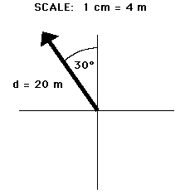
Vector Diagram

Slide 5
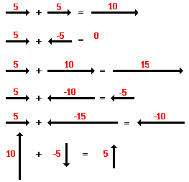
Vector Addition (1)

Slide 6
Vector Addition (2)

Slide 7
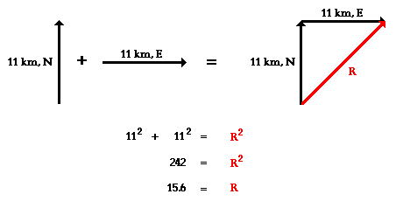
Resultant Vector (1)
Phytagorean Theorem

Slide 8
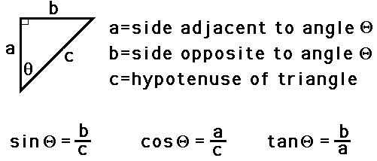
Resultant Vector (2)
Trigonometry

Slide 9
Relative Velocity (1)

Slide 10
Relative Velocity (2)

Slide 11
Relative Velocity (3)

Slide 12
Vector Multiplication (1)
Vector Scalar Multiplication
a(A + B) = a A + a B

Slide 13
Vector Multiplication (2)
Dot Product
Geometrically, the dot product of two vectors is the magnitude of one times the projection of the other along the first
A · B = AB cos θ

Slide 14
Vector Multiplication (3)
A · B = |  | A_{x} î | · | B_{x} î | + | A_{x} î | · | B_{y} ĵ | + | A_{x} î | · | B_{z} k̂
 | + | A_{y} ĵ | · | B_{x} î | + | A_{y} ĵ | · | B_{y} ĵ | + | A_{y} ĵ | · | B_{z} k̂
 | + | A_{z} k̂ | · | B_{x} î | + | A_{z} k̂ | · | B_{y} ĵ | + | A_{z} k̂ | · | B_{z} k̂
A · B = A_{x}B_{x} + A_{y}B_{y} + A_{z}B_{z}

Slide 15
Vector Multiplication (4)
Cross Product
Geometrically, the cross product of two vectors s the area of the parallelogram between them
A × B = AB sin θ n̂
A × (B + C) = (A × B) + (A × C)

Slide 16
Vector Multiplication (5)
A × B | = | A_{x} î | × | B_{x} î | + | A_{x} î | × | B_{y} ĵ | + | A_{x} î | × | B_{z} k̂
 | + | A_{y} ĵ | × | B_{x} î | + | A_{y} ĵ | × | B_{y} ĵ | + | A_{y} ĵ | × | B_{z} k̂
 | + | A_{z} k̂ | × | B_{x} î | + | A_{z} k̂ | × | B_{y} ĵ | + | A_{z} k̂ | × | B_{z} k̂
A × B = (A_{y}B_{z} − A_{z}B_{y}) î + (A_{z}B_{x} − A_{x}B_{z}) ĵ + (A_{x}B_{y} − A_{y}B_{x}) k̂

Slide 17
Vector Multiplication (6)
A × B = | î | ĵ | k̂
 | A_{x} | A_{y} | A_{z}
 | B_{x} | B_{y} | B_{z}
A × B = | A_{y} | A_{z} | î + | A_{x} | A_{z} | ĵ + | A_{x} | A_{y} | k̂
 | B_{y} | B_{z} |  | B_{x} | B_{z} |  | B_{x} | B_{y}
A × B = (A_{y}B_{z} − A_{z}B_{y}) î + (A_{z}B_{x} − A_{x}B_{z}) ĵ + (A_{x}B_{y} − A_{y}B_{x}) k̂

Slide 18
Exercise
A student drives his car 6.0 km, North before making a right hand turn and driving 6.0 km to the East. Finally, the student makes a left hand turn and travels another 2.0 km to the north. What is the magnitude of the overall displacement of the student?

Slide 19
Exercise
Max plays middle linebacker for South's football team. During one play in last Friday night's game against New Greer Academy, he made the following movements after the ball was snapped on third down. First, he back-pedaled in the southern direction for 2.6 meters. He then shuffled to his left (west) for a distance of 2.2 meters. Finally, he made a half-turn and ran downfield a distance of 4.8 meters in a direction of 240° counter-clockwise from east (30° W of S) before finally knocking the wind out of New Greer's wide receiver. Determine the magnitude and direction of Max's overall displacement.

Slide 20
Exercise
A motorboat traveling 4 m/s, East encounters a current traveling 3.0 m/s, North.
What is the resultant velocity of the motorboat?
If the width of the river is 80 meters wide, then how much time does it take the boat to travel shore to shore?
What distance downstream does the boat reach the opposite shore?

