Slide 1
Basic of Computer
Marcello Singadji, S.Kom, M.T
marcello.singadji@upj.ac.id
singadji@gmail.com

Slide 2
Learning objectives
Mampu menjelaskan sejarah perkembangan komputer
Mampu menjelaskan struktur dan organisasi komputer
Mendiskusikan fungsi dan interaksi sistem komputer
Mampu menjelaskan bagaimana komputer menyimpan dan memproses data
Mampu menjelaskan jenis media penyimpanan pada komputer

Slide 3
Learning objectives
Mampu menjelaskan 3 kategori dasar s/w
Memahami dan menjelaskan hubungan algoritma untuk s/w
Mampu menjelaskan faktor-faktor yang mempengaruhi kinerja komputer
Dapat menjelaskan sistem operasi dan sistem komputer modern
Memahami GUI

Slide 4
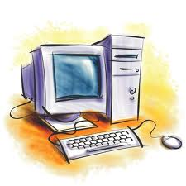
What is computer?
Sebuah perangkat elektronik yang menyimpan, mencari dan mengambil kembali, dan proses data, dan dapat diprogram dengan instruksi.
Sebuah komputer terdiri dari hardware dan software, dan bisa ada dalam berbagai ukuran dan konfigurasi.

Slide 6
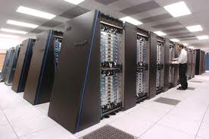
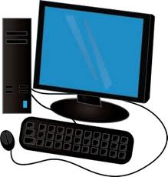
Types of Computers
Mini and Mainframe Computers
Very powerful, used by large organisations such an banks to control the entire business operation. Very expensive!
Personal Computers
Cheap and easy to use. Often used as stand-alone computers or in a network. May be connected to large mainframe computers within big companies.

Slide 7
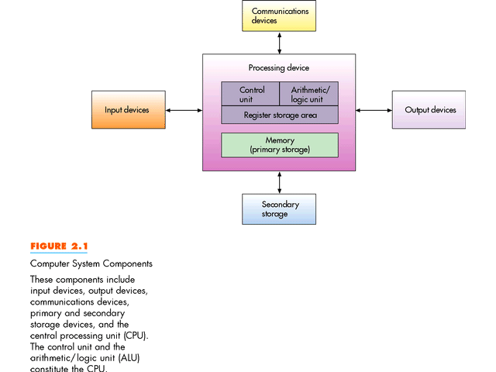
Computer System Components

Slide 8
Hardware & Software
The term hardware refers to the physical components of your computer such as the system unit, mouse, keyboard, monitor etc.
The software is the instructions that makes the computer work. Software is held either on your computers hard disk, CD-ROM, DVD or on a diskette (floppy disk) and is loaded (i.e. copied) from the disk into the computers RAM (Random Access Memory), as and when required.

Slide 9
Hardware Components
Input Devices -- "How to tell it what to do“
A keyboard and mouse are the standard way to interact with the computer. Other devices include joysticks and game pads used primarily for games.
Output Devices -- "How it shows you what it is doing“
The monitor (the screen) is how the computer sends information back to you. A printer is also an output device.

Slide 10
Hardware Components
Storage Devices -- "How it saves data and programs“
Hard disk drives
CD-ROM
DVD-ROM
Flash Memory

Slide 11
The CPU
CPU: the real computer
CPU (microprocessor)
Menginterpretasikan dan mengeksekusi instruksi dalam setiap program
Melakukan proses manupulasi data secara aritmatika dan logis

Slide 12
Main Parts of Computer
Memory -- "How the processor stores and uses immediate data“
RAM - Random Access Memory
The main 'working' memory used by the computer.
When the operating system loads from disk when you first switch on the computer, it is copied into RAM.
ROM – Read Only Memory
Read Only Memory (ROM) as the name suggests is a special type of memory chip that holds software that can be read but not written to.
A good example is the ROM-BIOS chip, which contains readonly software.

Slide 13
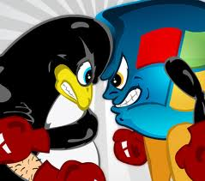
Compatibility
Tidak semua s/w dapat digunakan di setiap CPU
Macintosh dan intel
Linux program can’t run on windows
Tapi dapat dijalankan di pada proseor intel

Slide 14
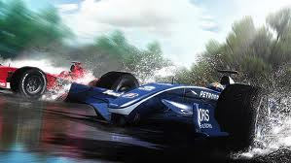
Some of the Factors That Impact on a Computer's Performance
CPU speed
RAM size
Hard disk speed and capacity
Machine Cycle Time
Time it takes to execute the instruction and execution phases
Clock Speed
A series of electronic pulses produced at a predetermined rate, that affect machine cycle time
Physical Characteristics of the CPU

Slide 15
Three Major Categories of S/W
Compiler other translator programs: enable programmers to create other software
Software aplications: serve as productivity tools to help computer users solve problems
Operating System

Slide 16
Software
Applications software
Word processing applications
Spreadsheets
Database
Payroll
Presentation tools
Desktop publishing
Multimedia applications

Slide 17
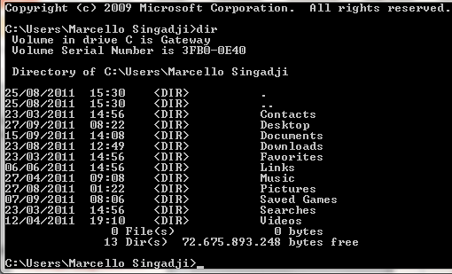
User Interface
The interface defines the look and feel of the computing experience from a human point of view
Desktop Operating Systems
MS-DOS is a disk operating system in which the user interacts using characters:
Letters
Numbers
Symbols

Slide 18
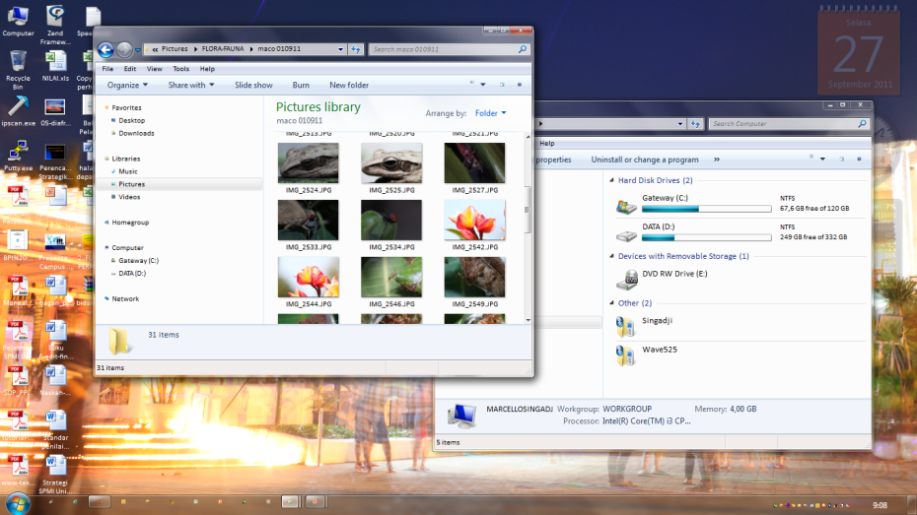
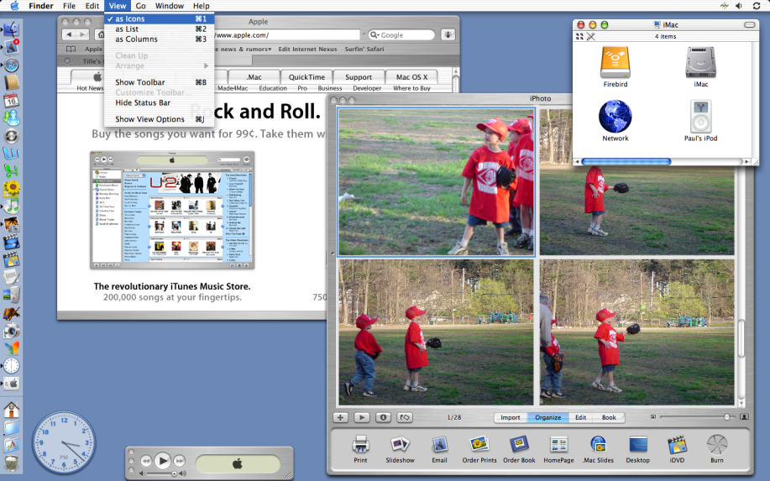
GUI (Graphical User Interface)
Mac OS was developed by Macintosh in 1984 using GUI
Microsoft Windows (1981-1992), is now the most popular operating system

Slide 20
Terima kasih

