Slide 1
Managing Global Human Resources
CHAPTER 17
Anggita Kusuma Dewi
Dyah Ayu Karyanti
Syahda Faturahmalia

Slide 2
Human Resources Challenges of International Business
HAL 604
Economic system
Cultural factors
Legal, political and labor relation
Ethics and codes of conduct

Slide 3
Adapting Human Resources Activities to Intercountry Differences
HAL 604 -605
Tenaga kerja di United States mencerminkan banyaknya budaya dan latar belakang etnik. Mereka berbagi nilai seperti apresiasi terhadap demokrasi untuk memudarkan perbedaan budaya.
Perusahaan yang memiliki anak perusahaan di luar negeri tidak menghadapi kesamaan.
Waktu libur di United Kingdom adalah 0 sampai 5 minggu per tahun di Luxembourg.
Di Italia tidak ada persyaratan khusus untuk representative boards of directors, sedangkan hal ini berlaku di Denmark.

Slide 4
Cultural Factors
HAL 605
Di United States, manajer berfokus pada bagaimana agar pekerjaan bisa diselesaikan.
Manajer di China berfokus kepada menciptakan lingkungan yang harmonis.

Slide 5
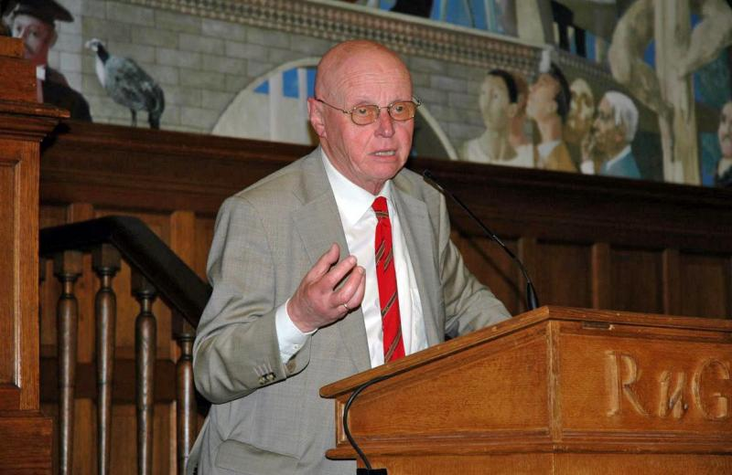
The Hofstede Study by Professor Geert Hofstede
HAL 606
Hofstede membagi masyarakat menjadi 5 klasifikasi ;
Jarak kekuasaan,
Individualisme,
“Masculinity”,
Penghindaran ketidakpastian,
Orientasi jangka panjang.

Slide 6
Economic System
HAL 606
Market Economies
Planned Economies
Mixed Economies
United States
North Korea
China

Slide 7
Legal, Political, and Labor Relation
HAL 606
Di India, perusahaan yang memiliki lebih dari 100 pekerja harus mendapatkan izin dari pemerintah untuk memecat karyawannya.
Akibat hukum komersial Jerman, Walmart meninggalkan Jerman.

Slide 8
Ethics and Code of Conducts
HAL 607
IBM membayar 10 juta dolaar untuk menetakan tuduhan, bahwa mereka telah disuap oleh pejabat China dan Korea Utara, untuk mendapatkan 54 juta dolar dikontrak pemerintah

Slide 9
Human Resources Abroad example: The Eropean Union
HAL 607
Minimum EU Wages
Working Hours
Termination of Employment

Slide 10
Human Resources Abroad example: China
HAL 607-608
Beberapa variasi praktek HRM di China dan perusahaan Barat
Recruiting
Compensation
Selection
Appraising

Slide 11
Staffing The Global Organization
HAL 608
1
Internasional Staffing
Home OR Locals ?
Locals
Expatriate
Home-Country Nationals
Third-Country Nationals
Using Locals
Using Virtual Teams
Using Expats

Slide 12
HAL 611
2
Offshoring
Menugaskan pekerja lokal ke luar negeri untuk melakukan pekerjaan yang sebelumnya dilakukan oleh pekerja domestik negara tujuan
3
Ethnocentric
Management Values and International Staffing Policy
Polycentric
Geocentric

Slide 13
HAL 612-615
4
Selection Testing
Selecting Expatriate Managers
Legal Issues
5
Traits Of Successful Expatriate
Advoiding Early Expatriate Returns
Family Pressures
What Employers Can Do

Slide 14
Training and maintaining employees abroad
HAL 616
1
ORIENTING AND TRAINING EMPLOYEES ON INTERNASIONAL ASSIGNMENT
ONGOING TRAINING
2
APPRAISING MANAGERS ABROAD

Slide 15
The Balance Sheet Approach
HAL 618-619
3
COMPENSATING MANAGERS ABROAD
EXPATRIATE PAY EXAMPLE
INCENTIVE
STEPS IN ESTABLISHING A GLOBAL PAY SYSTEM:
Set Strategy
Identify Crucial Executive Behaviors
Global Philosophy Framework
Identify Gaps
Systematize Pay Systems
Adapt Pay Polices

Slide 16
Centralization
HAL 619
4
LABOR RELATIONS ABROAD
Employer Organization
Union Recognition
Content and Scope of Bargamming

Slide 17
HAL 620
5
TERRORISM
TERRORISM, SAFETY AND GLOBAL HR
TAKING PROTECTIVE MEASURES
KIDNAPPING AND RANSOM INSURANCE
6
7
REPATRIATION: Problems & Solutions
IMPROVING PRODUCTIVITY THROUGH HR

Slide 18
Managing HR Locally: How To Put Into Practice A Global HR System
HAL 621
1
Developing a More Effective Global HR
Form Global HR Networks.
Remember That it’s More Important To Standardize ends and Competencies than specifics methods.
2
Making the Global HR System More Acceptable
Investigate pressures to differentiate and determine their legitimacy.
Try to work within the context of a strong corporate culture

Slide 19
HAL 622
3
“You can’t communicate enough”
Implementing The Global HR System
Dedicate adequate resources.

Slide 20
THANK YOU

