Slide 1
An Introduction of Information and Communication Technology
Pengantar Teknologi Informasi dan Komunikasi (PTIK)
By. WTFG Team

Slide 2
Why Social Networking?

Slide 3
Interesting to Write in Social Network
Hal menarik mengenai menulis di social network adalah semua orang dapat menjadi penulis dengan jangkauan global.
Karena semua orang dapat menulis di social network maka aturan penulisan menjadi relatif mengenai apa yang dikatakan dan siapa yang mengatakannya.
Di awal kemunculan social network, penulisan di social network dipengaruhi oleh gaya penulisan surat kabar sehingga pada dasarnya penulisan di social network dan media cetak kurang lebih sama.

Slide 4
Am I can Write in Social Network?
Kemampuan untuk melakukan penulisan dengan jangkauan yang tidak terbatas. Orang dapat menulis apa saja tanpa harus memikirkan gaya penulisannya. Mereka menjadi editor diri sendiri dan situasi ini menghasilkan gaya penulisan yang lebih santai

Slide 5
The Differences Writing on Social Network?
Sementara di social network, fleksibilitas penulisan sangatlah tinggi. Semua media dapat bersatu atau bercampur (convergence).
Media cetak, gambar, suara, video, animasi dapat digunakan untuk menceritakan cerita yang sama.
Hal ini sesuai dengan orang-orang yang menyukai gaya penulisan convergence yang melahirkan cara baru untuk menulis dan bercerita.

Slide 6
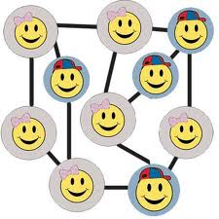
How is The Audiences?
Sifat pembaca di social network merupakan kekuatan pengubah penulisan social network.
Internet bersifat interaktif di mana pembaca dapat berkomunikasi secara cepat dan luas.
Komunikasi menjadi dua arah dan ini merubah gaya penulisan.

Slide 7
How to Write on Social Networking?
MENENTUKAN TUJUAN PENULISAN DAN TOPIK
MENYESUAIKAN TULISAN DENGAN PEMBACA
MELAKUKAN PENELITIAN UNTUK TOPIK
MELAKUKAN ORGANISASI UNTUK IDE
MELAKUKAN PENULISAN

Slide 8
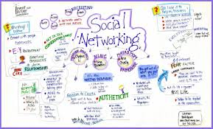

Slide 9
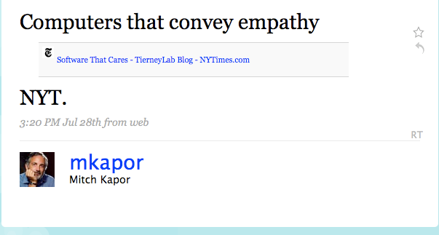
Twitter Talkback: What Makes a Quality Tweet?
1. Informative
Helps us learn. . .
This generally includes links to articles that help us learn about a subject in which we have interest. This is particularly useful from people who have a great deal of knowledge in a particular subject area, be it democracy, Buddhism, open source technology, or another subject, and who take the time to share what they know and discover.
Instead of needing to surf the web to stay up on all our interest areas, these tweets save us time and we can trust others to inform us of relevant information.

Slide 10
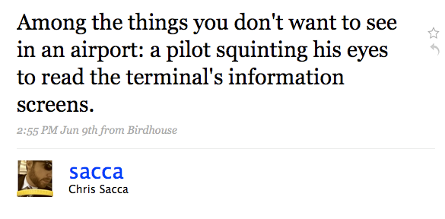
2. Humorous
Makes us smile…
Who doesn’t want to sign on to Twitter and be given a reason to smile? I am happy to do so any time, and welcome tweets that bring a little lightness to my day. Such tweets do not need to chide or make fun of anyone in particular, but can simply be in the form of sharing a joke, a new perspective, or a scene from one’s life that others may also enjoy.

Slide 11
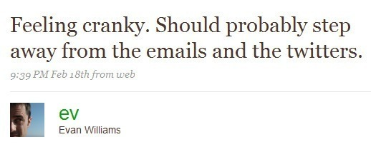
3. Personal
Tells us something about the person…
This is delicate, and probably the most challenging of all. Few of us likely want to know all the details of a person’s life: after all, we have our own life to live. However, we also want to get to know the person behind the tweets. Along with links to articles, tweets that give us insights into a person’s personality, interests, and concerns are helpful. When people reveal such information and show us the “backstory” of their life, we feel as if we better know them.

Slide 12
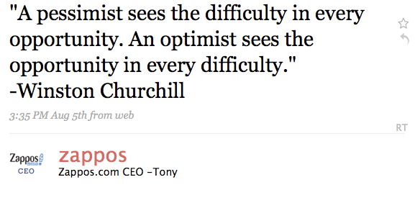
4. Inspiring
Helps us increase quality of our lives…
Most of us seek to live more wisely and effectively, and welcome tweets that provide us insight and inspiration on how to do so. These can include wisdom from that user or quotes the person has come across. These tweets serve both to inspire and to guide us on living with greater purpose and meaning.

Slide 14
Writing a “Good” Facebook Status Update
Include a photo
Photos have the most “weight” according to Facebook’s EdgeRank, which means status updates that include a photo will likely be shown to more of your fans.
Ask a question
Posing a question or including a Call to Action (CTA) is vital. Be sure your questions only require one word or a short phrase to answer, though. People’s Facebook walls are full of updates; the more effort they have to put in to respond, the less the chance they’ll interact with your status update. If you would like them to respond in some other way (e.g. LIKE your update), be sure to specifically write, “Click ‘LIKE’ if you agree!”.
Include a link
If you are telling your fans about a new product or blog post you want them to check out, be sure to include the URL (bit.ly is OK, too) in your update.
Tag relevant pages in your status updates
If your update mentions another business or organization, be sure to tag them in your status update. Doing so will alert those pages that you mentioned them. Over time, this is a great way to build the potential for cross-promotional opportunities or them giving your brand a shout on their page.

Slide 15
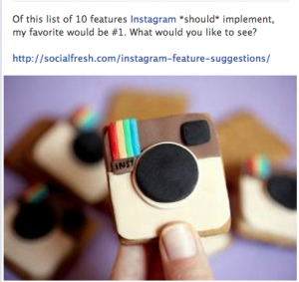

Slide 16
Lecturer: RR. Dewi Nilamsari S.Si., M.Kom.

