Slide 1
ETIKA
Dosen: Andhika Wirawan. S.IP, M.Si
Bobot nilai : HP: 081289047589
UAS : 40% email: Andhika_wirawan@yahoo.com
UTS : 30%
Tugas : 30 %
Bonus after session quiz : 2 point per answer
Referensi Buku:
Multi cultural manners (essential Rules of etiquette for the 21st Century) : Norine Dresser
Ethics Theory and Practice Eleventh Edition : Jacques P. Thiroux & Keith W. Krasemann
Etika seri filsafat : K Bertens
Pengantar Filsafat : Inu Kencana Syafiie

Slide 2
Tugas termasuk:
Presentasi diskusi, Cooperative learning, problem base learning, simulation berupa role play dan project based learning berupa social service.
UTS dan UAS: bisa berupa essay, paper, close book, open book, take home test atau verbal test.

Slide 3
EDUCATION AND QUALIFICATIONS
• 2012 – Now : postgraduate marketing Communications Budi Luhur University.
• 2009 – 2012 : postgraduate administration science majoring public policy administration STIA YAPPAN
• 2002 – 2006: Social and Politics majoring international relation Budi Luhur University.
• 1999 – 2002 : Senior high school at SMU IV Tangerang.
• 1996 – 1999 : Junior high school at SMP I Tangerang
• 1990 – 1996 : Elementary school at Kramat Pela IX pagi, Jakarta Selatan.
KEY I.T. SKILLS
• Word, Excel, PowerPoint, SAP/ WMS SAP, Internet & Email
MEMBERSHIP
• Vice president of HIMAHI ( Himpunan Mahasiswa Hubungan Internasional ) period 2003-2004.
• FISIP SENATE Head of R&D Period 2004-2005.
SOCIAL SERVICE
• Study tour with Jabal Nur orphanage September 10 2012
RESEARCH
• KEMITRAAN STRATEGIS SEBAGAI INSTRUMEN PENYELESAIAN DAMAI SENGKETA PERBATASAN CINA-INDIA (1997-2005)
• EVALUASI KEBIJAKAN PUBLIK RUANG TERBUKA HIJAU PUBLIK (STUDI KASUS PEMBANGUNAN TAMAN DAN SKATEPARK DI JALAN MUHAMMAD YAMIN KOTA TANGERANG)

Slide 4
EVENT MEMBER & TRAINING
• Phanter Laga Wisata Jakarta , Juli 15th 2003. (Head of the field team).
• Praktik diplomasi, Jakarta , June 24th 2004 Budi Luhur University Head of United Nation Staff officer ( simulation )
• The art of communication seminar, Jakarta , June 2nd 2004 Budi Luhur University . Seremony manager
• insurance marketing training program (BNILIFE at panglima polim 2003)
• Personal Banking training program (Danamon Campus Ciawi 2006)
• 5 R ISO support training program (Inbisco at Daan Mogot 2007)
• LEMHANAS (nilai-nilai kebangsaan) 24-29 September 2012
• MPR RI dan KOPERTIS WILAYAH III (Sosialisasi 4 Pilar/ Pancasila,UUD 1945,Bhinneka Tunggal Ika,NKRI ) 14-18 Februari 2013

Slide 5
CAREER SUMMARY
SALES EXECUTIVE AT OSIM (2003)
• Maintain the store compliance in all areas, including customer care and product’s acknowledge
• Supporting supervisor and other staff to help create successful and productive team and eventually achieving target.
• Maximising every sales opportunity
FINANCIAL CONSULTANT AT BNILIFE (2003)
• Prospecting list of data via phonemarketing
• Pursuing people to use insurance benefit by dirrectselling.
• Handling and swiftly resolving customer complaints in a professional and effective manner
• Introducing product awareness and feedback forms with most useful results
PERSONAL BANKING OFFICER AT DANAMON BANK ( August 2006- September 2006)
• Maintain bank costumer with complement service and interesting product
• Maximising every sales opportunity by promoting the highest standards of customer care and recognising potential development and training opportunities
• Reviewing and evaluating weekly KPI achievement and producing an end of week spreadsheet
• Reporting to the Branch Manager with responsibility of nearly 50 account costumer and consulting the issue around marketing strategy
IMPRESS FUND OFFICER AT INBISCO NIAGATAMA SEMESTA / MAYORA GROUP ( September 2006-September 2007)
• Managing fund for logistic operational JABOTABEK area.
• Ensuring the allocation target of the fund with analyzing procedure of the distribution cost.
• Reporting daily funding operational to the ledger to receive refund.
WMS ADMIN AT INBISCO NIAGATAMA SEMESTA / MAYORA GROUP ( September 2007-Juni 2008)
• Manage the warehouse outbond delivery (covering Mayora logistic operational for national area) administration process including create goods picking list according to batch so as handle the goods issue proscess.
• Creating warehouse management transfer order for the purpose of fullfiling goods delivery quantity.
• Controling the goods replenishment to make goods traffic kept in order.
• Reporting the daily bottle neck factor of administration process.

Slide 6
ADMINISTRATION SUPERVISOR AT INBISCO NIAGATAMA SEMESTA / MAYORA GROUP ( Juni 2008-Desember 2008)
• Maintaining good staff relations through effective communication, leadership, discipline and motivation.
• Encouriging the highest possible standard of organization service from the team and maintaining the smooth day to day operation of warehouse administration process.
• Ensuring that all reports from every unit of administration is done well and distributed to people responsible.
• Responsible for all of the goods mutation and transaction.
• Monitoring the SAP (ver 6.2)warehouse activity reports including coordinating with the taskforce team to solve if theres any problem occure on the reports.
• Controlling pallet stock, needs and movement of the logistic company and also all factory.
• Maximing service excellent of the department concerning the fulfillment of goods for the schedule of fixed daily delivery order.
• Receive bottle neck report to be process into day to day KPI (inbound and outbond) achievement, and send to people responsible for the process of evaluating.
• handling the system adjustment process post stock-opname by accounting department.
ACCOUNT OFFICER (CENTRAL JAVA GENERAL TRADE) AT INBISCO NIAGATAMA SEMESTA / MAYORA GROUP ( Desember 2008- 31 Mei 2009)
• Handling the system processing of fix delivery outbond schedule of Central Java sub-distribution agents, the process included creating quotation, sales order to delivery order.
• Maintaining the service level to all the included agents of Central Java.
• Controling the issue of sub-distribution agents such as, relocation, Special purchase order, Reshuffle, Hold Product and up-loading item data to S.A.P (ver 7 E.C.C 6)
• Monitoring and ensuring all the printed delivery order have their shipment vendor for delivery by coordinating to transportation division.

Slide 7
LECTURE AT BUDI LUHUR UNIVERSITY ( 1 April 2009 –Now)
• Teaching for The Faculty of Political science, The Faculty of Architecture and Electro and The Faculty Of Communication Science
• Object of teaching: China’s global politics, International Relation at the Asia Pacific, Indonesia’s Social and Cultural System, Introduction to Political Science, Introduction to IR Political Economy, English for international relation, creative thinking, political communication, Sociology, Civic Education(Pancasila LEMHANAS certified), Public opinion, Indonesia’s Communication system, Indonesia’s Foreign Politics.
HEAD OF ACADEMIC CONSULTANT FOR STUDENT (2012-Now)
• maintaining the academy procedural rules and mechanism of the student such as ensuring that the student take the right subject study and suits the table of curriculum.
• Handling complaints from the student concerning their academical problems and their interaction with other academic consultants.
• Responsible for the achievement of 28 academic consultants.
• Controlling the consultation schedule of 28 academic consultants.
• Monitoring the report from the academic consultants.
• Reporting and coordinating with the head of Program Study (Ketua Program Study)
• Evaluating the work of 28 academic consultants.
LECTURE AT PARAMADINA UNIVERSITY ( 1 March 2013 – Now)
• Teaching for The Faculty of Philosophy and civilization (International Relation)
• Object of teaching: International Communication.

Slide 8
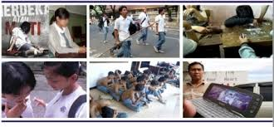
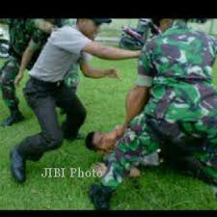
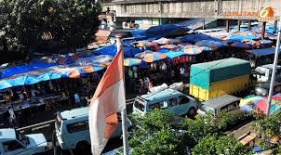
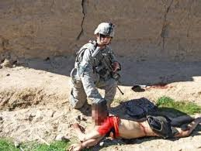
Bagaimana akibatnya apabila dunia ini tanpa adanya etika?
Homo homini lupus
Bellum omnium contra omnes

Slide 9
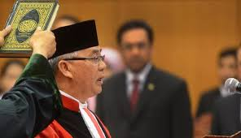
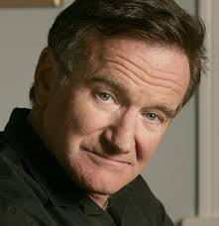
TUJUAN UTAMA MEMPELAJARI ETIKA
Memutuskan mana aksi atau perilaku yang “dapat diterima” ataupun tidak (rules of the game)
Memahami berbagai kontroversi dan dilema dalam kehidupan dan pemikiran.
Mencari kebenaran melalui diskusi rasional
Mencari sebuah konsistensi.
Komitmen kepada rasionalitas.
Yang terpenting adalah memahami semua pemikiran dan tindakan memiliki sebuah konsekuensi

Slide 10
Core value UPJ dan Visinya
Pembangunan manusia yang Humanis, Berwawasan Lingkungan Berkelanjutan, dan berjiwa kewirausahaan/kepeloporan (Eco-Sustainable-Development and the Spirit of Entrepreneur)
Visi UPJ ; ‘membentuk insan Indonesia yang gemar belajar, kreatif, mandiri, berbudi pekerti luhur’

Slide 11
DEFINISI ETIKA
Etika berasal dari kata Yunani (Ethos) yang berarti karakter
Moralitas berasal dari kata Latin ( Moralis) yang berarti tata krama/kebiasaan baik
Morality: set of beliefs and practices about how to lead a good life
Ethics : A rational reflection on morality
DEFINISI FILSAFAT
Dalam bahasa Yunani kata philosophia merupakan gabungan dari dua kata, yakni “philo” yang berarti “cinta” dan “sophos” yang berarti “kebijaksanaan”. Dengan demikian, secara etimologi filsafat mempunyai arti “cinta akan kebijaksanaan” (love of wisdom). (Muhamad Mufid: 2009)
makna daripada filsafat, yaitu:
1) Filsafat adalah suatu sikap tentang hidup dan tentang alam semesta;
2) Filsafat ialah suatu metode berpikir reflektif, dan penelitian penalaran;
3) Filsafat ialah suatu perangkat masalah-masalah;
4) Filsafat ialah seperangkat teori dan sistem berpikir. (Burhanuddin Salam: 2009)
Berpikir dikatakan berfilsafat, apabila berpikir tersebut memiliki tiga ciri utama, yaitu: radikal, sistematik, dan universal.

Slide 12
Tema-tema pokok dalam etika: hati nurani, kebebasan, tanggung jawab, moral, hak dan kewajiban, keutamaan
Hubungan Etika dengan Ilmu Filsafat
Filsafat adalah ilmu pengetahuan yang berusaha mengkaji segala sesuatu yang ada dan yang mungkin ada dengan menggunakan pikiran. Bagian-bagiannya meliputi:
1. Metafisika yaitu kajian dibalik alam yang nyata,
2. Kosmologia yaitu kajian tentang alam,
3. Logika yaitu pembahasa tentang cara berpikir cepat dan tepat,
4. Etika yaitu pembahasan tentang tingkah laku manusia,
5. Teologi yaitu pembahasan tentang ketuhanan,
6. Antropologi yaitu pembahasan tentang manusia.

Slide 13
seseorang disebut ber etika dan bermoral bila mereka memiliki perilaku, karakter baik?
Bagaimana hubungan antara baik, buruk, benar atau salah berdasarkan pada aksi manusia?
Karakteristik dari baik, buruk, benar atau salah dan etis atau tidak etis.
Kebaikan suatu perbuatan harus selalu mengacu kepada pengalaman manusia dan hubungan antar manusia.
Contoh: ilmu dan kekuasaan.

Slide 14
Istilah
Amoral: contoh Colin Pitchfork, membunuh dan memperkosa 2 gadis di Inggris. Setelah diselidiki ternyata Pitchfork memiliki perilaku amoral atau sakit secara kejiwaan yang ditandai dengan; instabilitas emosi, tidak belajar dari pengalaman, mengerti akan hukum dan etika namun tidak memahami artinya, Pitchfork juga tidak pernah menyesali perbuatannya.
Non moral: mobil, senjata api, pisau, motor. Benda benda mati ini kemudian bisa digunakan untuk hal yang buruk ataupun baik.

Slide 15
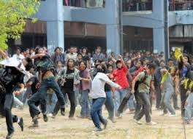
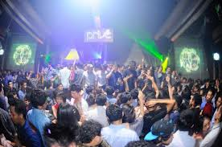
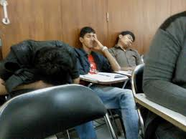
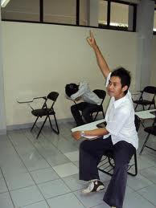
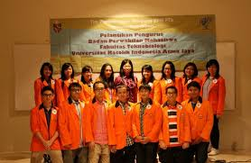
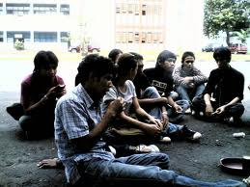
Etika memahami mana yang benar dan salah dan membangun kesadaran

Slide 16
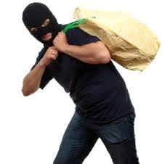
Etika dan Etiket
Etiket mengandung arti sopan santun atau tata cara berperilaku “yang dianggap” sopan oleh sebuah kebudayaan maupun kepercayaan.
Contoh:
Sementara etika lebih menyangkut
Masalah moral seperti mencuri:

Slide 17
Berbagai pembagian etika:
Etika deskriptif
Melukiskan dan mempelajari moralitas yang terdapat dalam suatu kebudayaan atau subkultur tertentu namun tidak memberikan penilaian.
2. Etika normatif
Tidak lagi hanya melukiskan masalah-masalah moralitas namun juga memberikan penilaian berdasarkan norma yang sesuai.
3. Metaetika
Mempelajari mengenai bahasa etis dan logika khusus dari ucapan-ucapan etis.

Slide 19
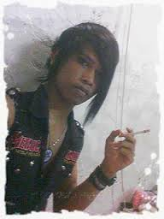
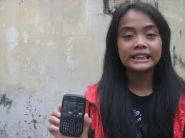
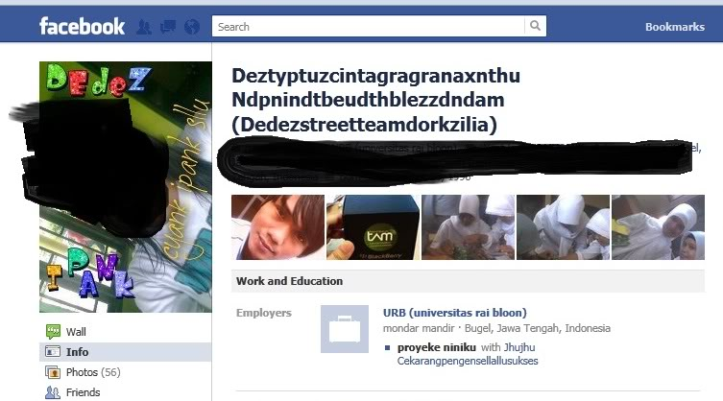
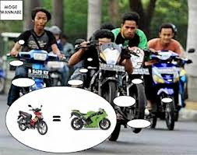
Tiga ciri menonjol situasi etis dalam dunia modern:
Pluralisme moral.
Muncul masalah etis baru
Kepedulian etis universal
Pluralisme moral

Slide 20
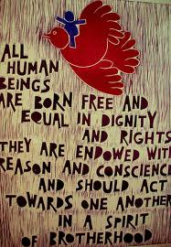
Kepedulian etis universal

Slide 21
dd

