Slide 1
Information Systems Development
Introduction to Information System
Marcello Singadji | marcello.singadji@upj.ac.id

Slide 2
Learning Objectives
explain the overall process of developing a new software application;
explain the differences between software development methodologies;
understand the different types of programming languages used to develop software;
understand some of the issues surrounding the development of websites and mobile applications;
identify the four primary implementation policies.
Notes:
Tujuan Pembelajaran:
Memahami perbedaan data, informasi, dan pengetahuan.
Memahami perbedaan arsitektur teknologi informasi dan infrastruktur teknologi informasi.
Mampu mendeskripsikan lingkungan bisnis global dan infrastruktur teknologi informasi yang baru.
Mendiskusikan hubungan antara tekanan bisnis, tanggapan/kesiapan perusahaan, dan sistem informasi.

Slide 3
Programming
Programming is the process of creating a set of logical instructions for a digital device to follow using a programming language
Coding

Slide 4
Systems-Development Life Cycle
SDLC was developed for large, structured projects.
Preliminary Analysis
System Analysis
System Design
Programming
Testing
Implementation
Maintenance

Slide 5
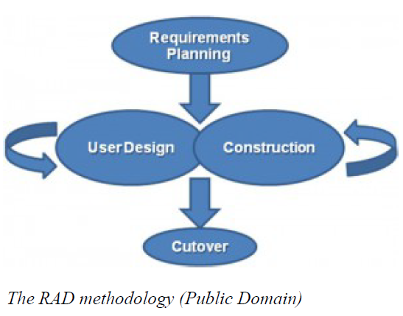
Software-Development Methodologies
Rapid Application Development
Softwaredevelopment (or systems-development) methodology that focuses on quickly building a working model of the software, getting feedback from users, and then using that feedback to update the working model.

Slide 6
Software-Development Methodologies
Agile Methodologies
small cross-functional teams that include development-team members and users
daily status meetings to discuss the current state of the project
short time-frame increments (from days to one or two weeks) for each change to be completed
at the end of each iteration, a working project is completed to demonstrate to the stakeholders
The goal of the agile methodologies is to provide the flexibility of an iterative approach while ensuring a quality product

Slide 7
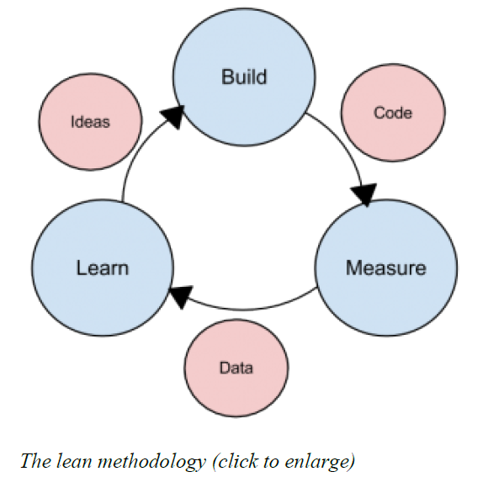
Software-Development Methodologies
Lean Methodology
One last methodology we will discuss is a relatively new concept taken from the business bestseller The Lean Startup, by Eric Reis
focus is on taking an initial idea and developing a minimum viable product (MVP)

Slide 8
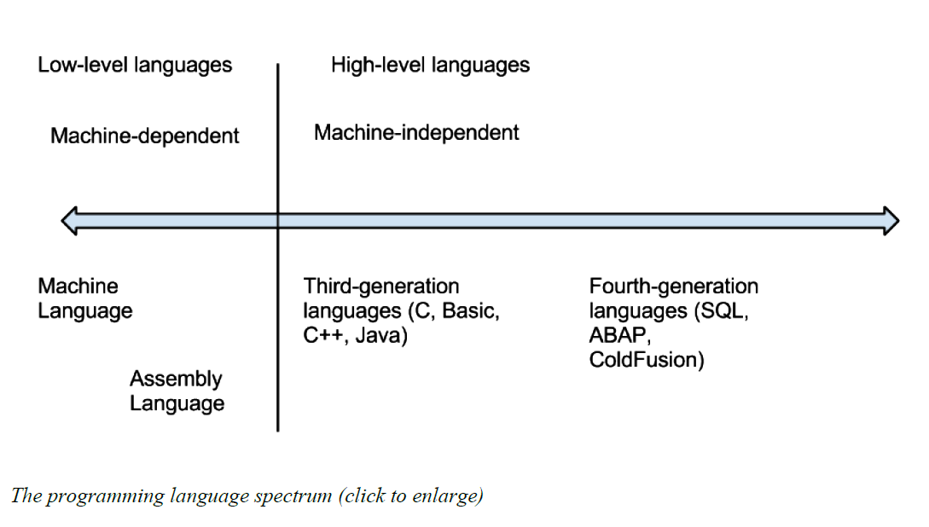
Programming Languages
Software developers create software using one of several programming languages

Slide 9
Compiled vs. Interpreted
Compiled language, the program code is translated into a machine-readable form called an executable that can be run on the hardware
C
C++
Interpreted language
PHP
PERL
Python

Slide 10
Procedural vs. Object-Oriented
Procedural programming language is designed to allow a programmer to define a specific starting point for the program and then execute sequentially
focuses on the sequence of activities to be performed
Object-oriented programming language is set up so that the programmer defines “objects” that can take certain actions based on input from the user
focuses on the different items being manipulated

Slide 11
Programming Tools
To write a program, a programmer needs little more than a text editor and a good idea
To be more efficient at programming, additional tools, such as an integrated development environment (IDE) or computer-aided software-engineering (CASE) tools, can be used
IDE
Notepad++, Microsoft Visual Studio
CASE tools
Visual Paradigm, Rational Rose, Rational Robot, Easy Case

Slide 13
Referensi
Introduction to Information Systems, Third Edition, R. Kelly Rainer Jr, Casey G. Cegielski, Wiley

