Slide 1
Lecture 03 Perceptron
By:
Nur Uddin, Ph.D

Slide 2
Model of Neuron: Perceptron

Slide 3
Perceptron

Slide 4
Elements of Perceptron
A set of synapses, each synapse is characterized by a weight to strength the input signals.
An adder for summing the weighted input signals.
An activation function for limiting the amplitude of the output of a neuron
A bias for increasing or lowering the net input of the activation function.

Slide 5
Perceptron computation

Slide 6
Perceptron computation (Cont’d)

Slide 7
Activation Function
Threshold function

Slide 8
Activation Function (Cont’d)
Sigmoid function

Slide 9
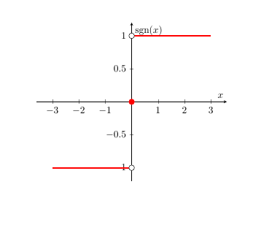
Activation Function (Cont’d)
3. Signum function

Slide 10
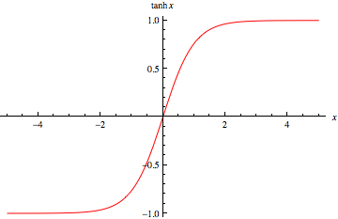
Activation Function (Cont’d)
4. Hyperbolic tangent function

Slide 11
Signal-Flow Graph
Signal-flow graphs, with a well-defined set of rules, were originally developed by Mason (1953, 1956) for linear networks.
Signal-flow graphs do provide a neat method for the portrayal of the flow of signals in a neural network.
A signal-flow graph is a network of directed links (branches) that are interconnected at certain points called nodes.
A typical node j has an associated node signal x_{j}.
A typical directed link originates at node j and terminates on node k; it has an associated transfer function, that specifies the manner in which the signal y_{k} at node k depends on the signal x_{j} at node j.

Slide 12
Rules of Signal-Flow Graph
Rule 1: A signal flows along a link only in the direction defined by the arrow on the link.
Two different types of links in NN:
1. Synaptic links : a linear input–output relation.
2. Activation links : a nonlinear input–output relation.

Slide 13
Rules of Signal-Flow Graph (Cont’d)
Rule 2: A node signal equals the algebraic sum of all signals entering the node via the incoming links.

Slide 14
Rules of Signal-Flow Graph (Cont’d)
Rule 3: The signal at a node is transmitted to each outgoing link originating from that node with the same value.

Slide 15
Exercise 1
Draw signal flow graph of neuron

Slide 16
Architectural Graph of Neuron

Slide 17
Feedback
Feedback: applying the system output as part the system input.
: closed-loop operator
: open-loop operator

Slide 18
Example 2
Infinite-duration impulse response (IIR)

