Slide 1
Discrete Mathematics Lecture 1: Introduction
By:
Nur Uddin, Ph.D

Slide 2
What is discrete?
Discrete : distinct or not connected

Slide 3
Discrete vs Continuous

Slide 4
Natural numbers vs real numbers
Natural numbers are discrete while real numbers are continuous.

Slide 5
What is discrete mathematics?
Discrete mathematics is the study of discrete objects.

Slide 6
Why we need to study discrete mathematics?
Computer works in a discrete system (digital)
Discrete mathematics is the basic in computer studies and applications, e.g.:
Software development
Computer security (cryptography)
Automata
etc

Slide 8
Syllabus

Slide 9
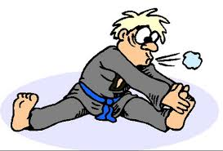
Warming up

Slide 10
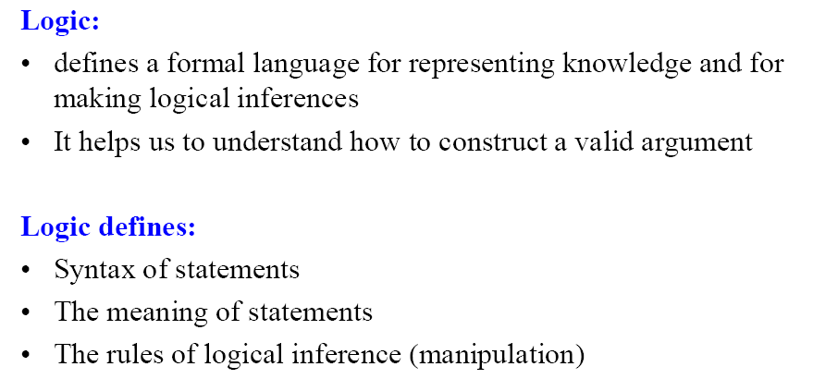
Logic

Slide 11
Proportional Logic

Slide 12
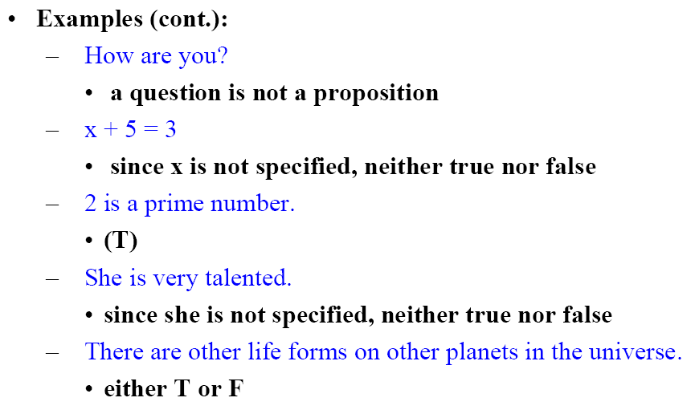
Proportional Logic

Slide 13
Composite Statements

Slide 14
Composite Statements

Slide 15
Negation

Slide 16
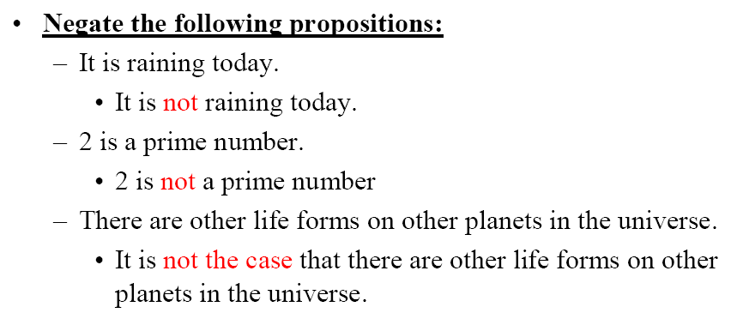
Negation

Slide 17
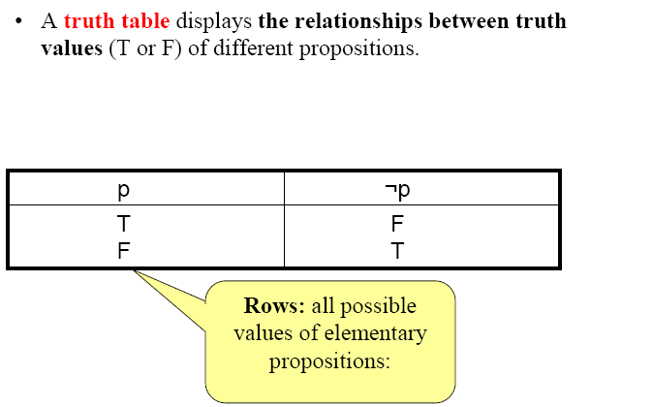
Negation

Slide 18
Conjunction

Slide 19
Disjunction

Slide 20
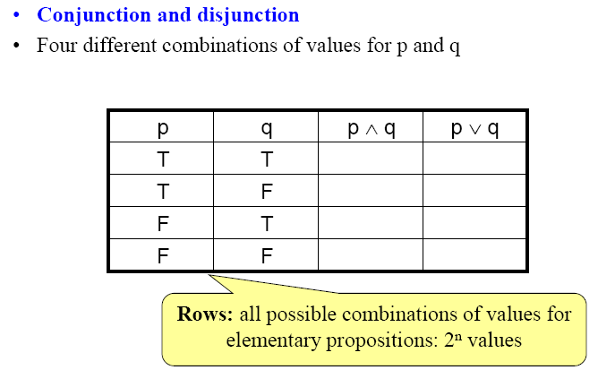
Truth Table

Slide 21
Exclusive OR

Slide 22
Implication

Slide 23
Implication

Slide 24
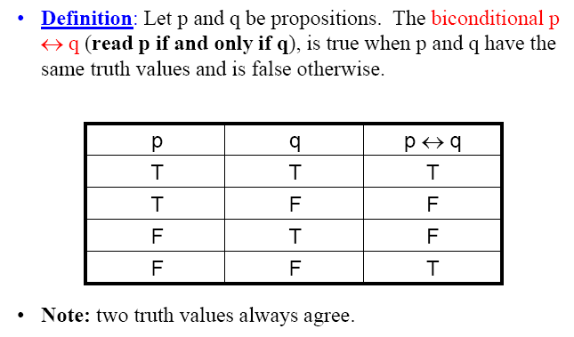
Biconditional

