Slide 1
Data Base System Lecture 6: Relational Model
By:
Nur Uddin, Ph.D

Slide 2
What will we learn?
The origins of the relational model.
The terminology of the relational model.
How tables are used to represent data.
The connection between mathematical relations and relations in the relational model.
Properties of database relations.
How to identify candidate, primary, alternate, and foreign keys.
The meaning of entity integrity and referential integrity.
The purpose and advantages of views in relational systems.

Slide 3
Introduction
The Relational Database Management System (RDBMS) has become the dominant data-processing software in use today.
It is based on the relational data model proposed by E. F. Codd (1970).
In the relational model, all data is logically structured within relations (tables).
Each relation has a name and is made up of named attributes (columns) of data.
Each tuple (row) contains one value per attribute.
A great strength of the relational model is this simple logical structure.

Slide 4
Terminology
Relation
A relation is a table with columns and rows.
Relations are used to hold information about the objects to be represented in the database.
Attribute
An attribute is a named column of a relation.
A relation is represented as a two dimensional table in which the rows of the table correspond to individual records and the table columns correspond to attributes.
Domain
A domain is the set of allowable values for one or more attributes.

Slide 5
Terminology (cont’d)
Tuple
A tuple is a row of a relation.
Degree
The degree of a relation is the number of attributes it contains.
Cardinality
The cardinality of a relation is the number of tuples it contains.

Slide 6
Mathematical Relation
Suppose that we have two sets, D1 and D2, where D1 = {2,4} and D2 = {1, 3, 5}.
The Cartesian product of these two sets, written D1 x D2, is the set of all ordered pairs such that the first element is a member of D1 and the second element is a member of D2.

Slide 7
Database Relation
Relational schema
A named relation defined by a set of attribute and domain name pairs.
Example:
{(branchNo: B005, street: 22 Deer Rd, city: London, postcode: SW1 4EH)}
Relational database schema
A set of relation schemas, each with a distinct name.

Slide 8
Properties of relation
A relation has the following properties:
the relation has a name that is distinct from all other relation names in the relational schema;
each cell of the relation contains exactly one atomic (single) value;
each attribute has a distinct name;
the values of an attribute are all from the same domain;
each tuple is distinct; there are no duplicate tuples;
the order of attributes has no significance;
the order of tuples has no significance, theoretically. (However, in practice, the order may affect the efficiency of accessing tuples.)

Slide 9
Relational Keys
Superkey
An attribute, or set of attributes, that uniquely identifies a tuple within a relation.
Candidate key
A superkey such that no proper subset is a superkey within the relation.
Primary key
The candidate key that is selected to identify tuples uniquely within the relation.
Foreign key
An attribute, or set of attributes, within one relation that matches the candidate key of some (possibly the same) relation.

Slide 10
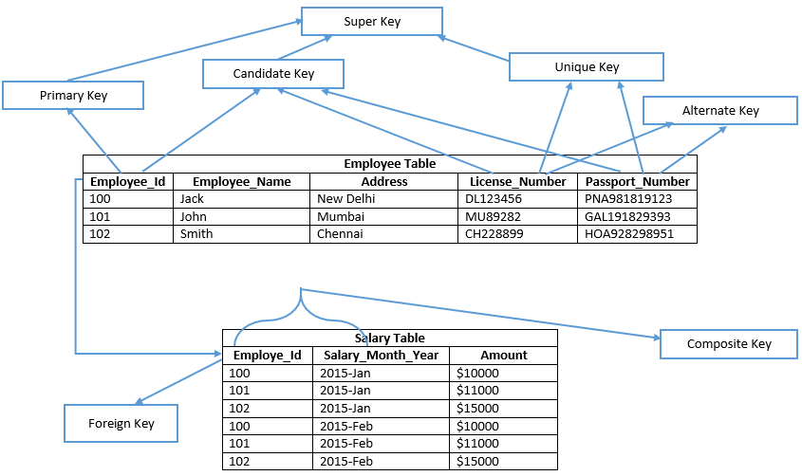
Relational Keys

