Slide 1
Data Base System Lecture 2: Introduction to Database
By:
Nur Uddin, Ph.D

Slide 2
General Definition
Database is a collection of related data.
Database management system (DBMS) is a software that manages and controls access to the database.
Database application is simply a program that interacts with the database at some point in its execution.
Database system as a collection of application programs that interact with the database along with the DBMS and the database itself.

Slide 3
Traditional File-Based Systems
File-based system is a collection of application programs that perform services for the end-users, such as the production of reports.
Each program defines and manages its own data.
File-based system is largely obsolete.

Slide 4
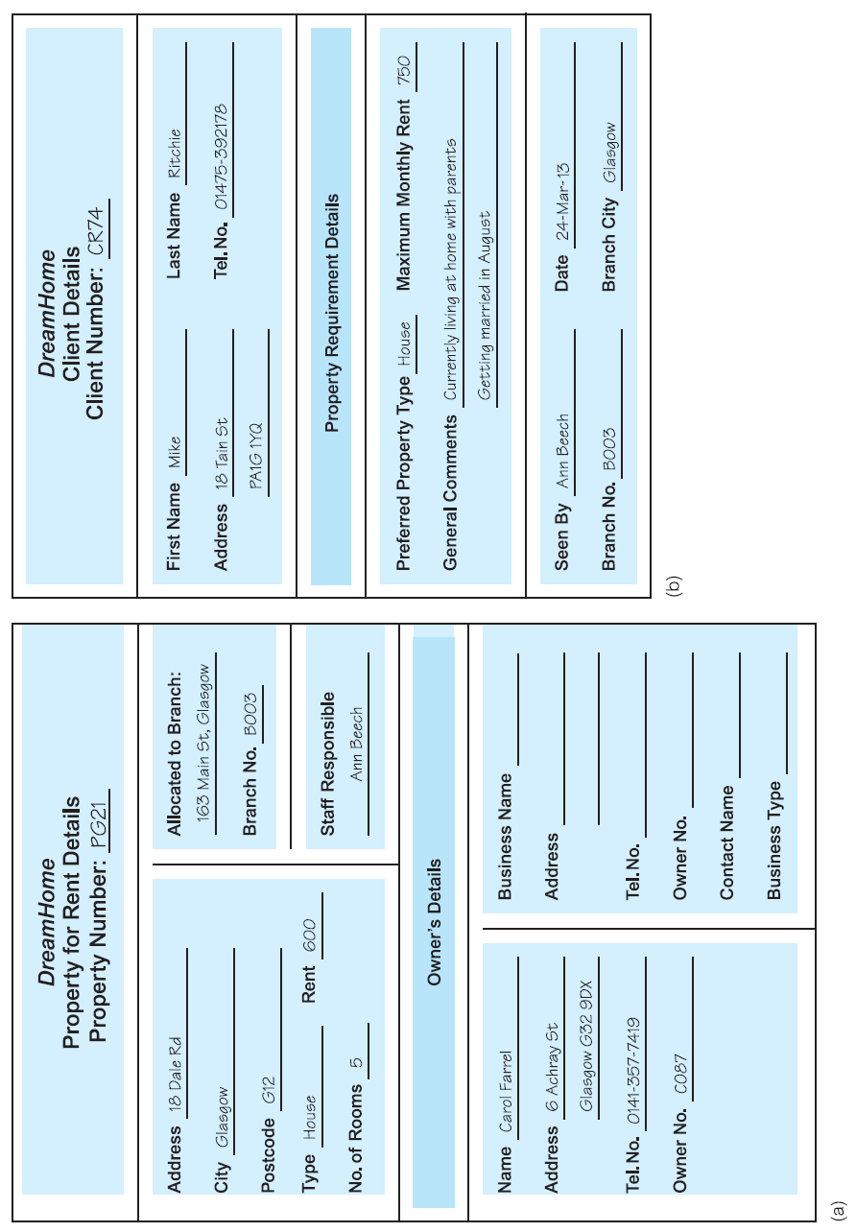
Sales Department Form

Slide 5
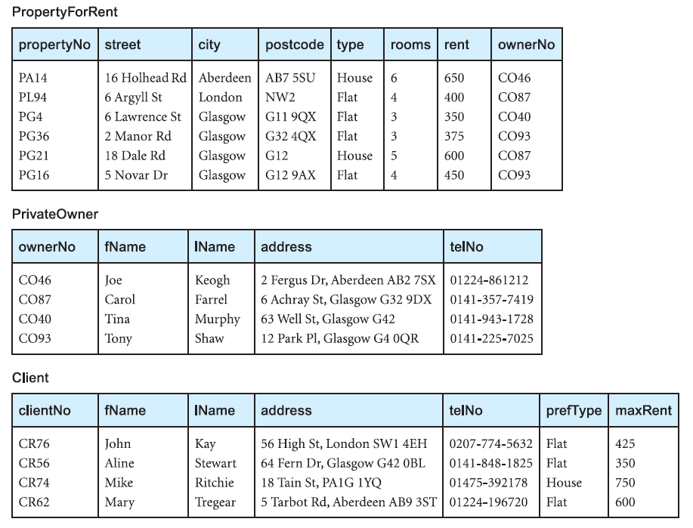
Sales Department Files

Slide 6
Contracts Department Form

Slide 7
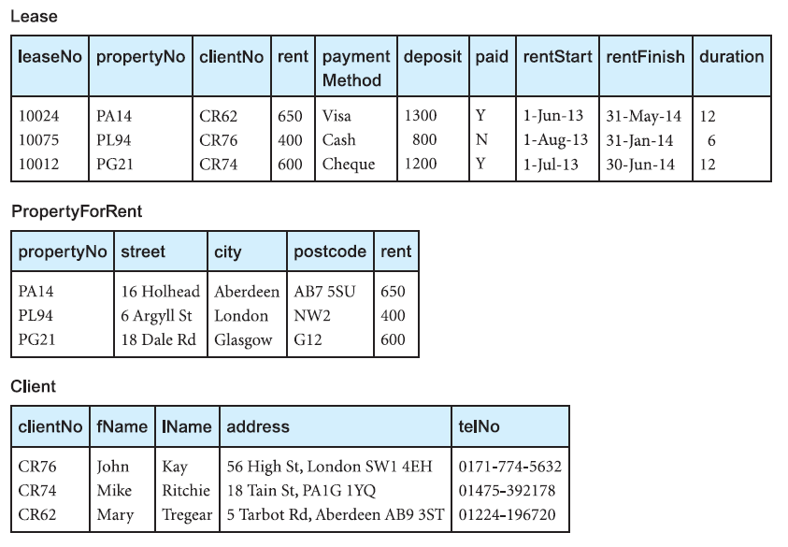
Contracts Department Files

Slide 8
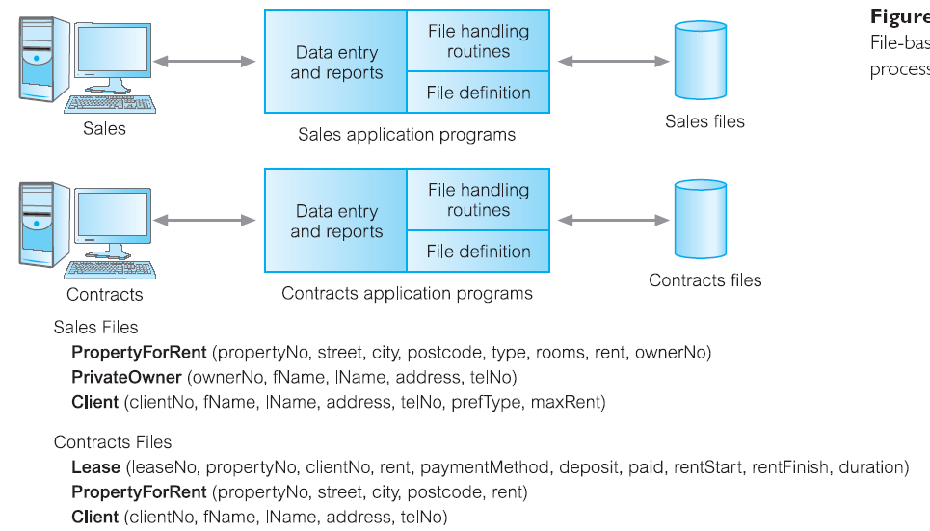
File-Base Processing

Slide 9
Limitation of File-Base Approach
Separation and isolation of data
Duplication of data
Data dependence (difficult to change the structure)
Incompatible file formats (different software)
Fixed queries/proliferation of application programs

Slide 10
Database Approach
Limitations of the file-based approach can be attributed to two factors:
The definition of the data is embedded in the application programs, rather than being stored separately and independently.
There is no control over the access and manipulation of data beyond that imposed by the application programs.
A new approach was required and what emerged were the database and the Database Management System (DBMS).

Slide 11
Database
Database is a shared collection of logically related data and its description, designed to meet the information needs of an organization.
The database is a single, possibly large repository of data that can be used simultaneously by many departments and users.
Instead of disconnected files with redundant data, all data items are integrated with a minimum amount of duplication.
The database is no longer owned by one department but is a shared corporate resource.

Slide 12
Database
The database holds not only the organization’s operational data, but also a description of this data. For this reason, a database is also defined as a self-describing collection of integrated records.
The description of the data is known as the system catalog (or data dictionary or metadata—the “data about data”). It is the self-describing nature of a database that provides program–data independence.

Slide 13
Database Management System (DBMS)
DBMS is a software system that enables users to define, create, maintain, and control access to the database.
DBMS provides the following facilities:
define a database through a Data Definition Language (DDL)
insert, update, delete, and retrieve data from the database through a Data Manipulation Language (DML).
The DML to provide a general inquiry facility to this data, called a query language and the most common is the Structured Query Language (SQL)
SQL is the standard language for relational DBMSs.

Slide 14
Database Application Programs
Database application program is a computer program that interacts with the database by issuing an appropriate request (typically an SQL statement) to the DBMS.

Slide 15
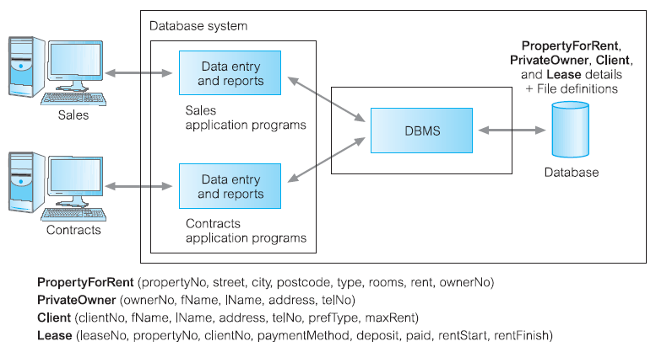
Database Processing

Slide 16
Components of the DBMS Environment

Slide 17
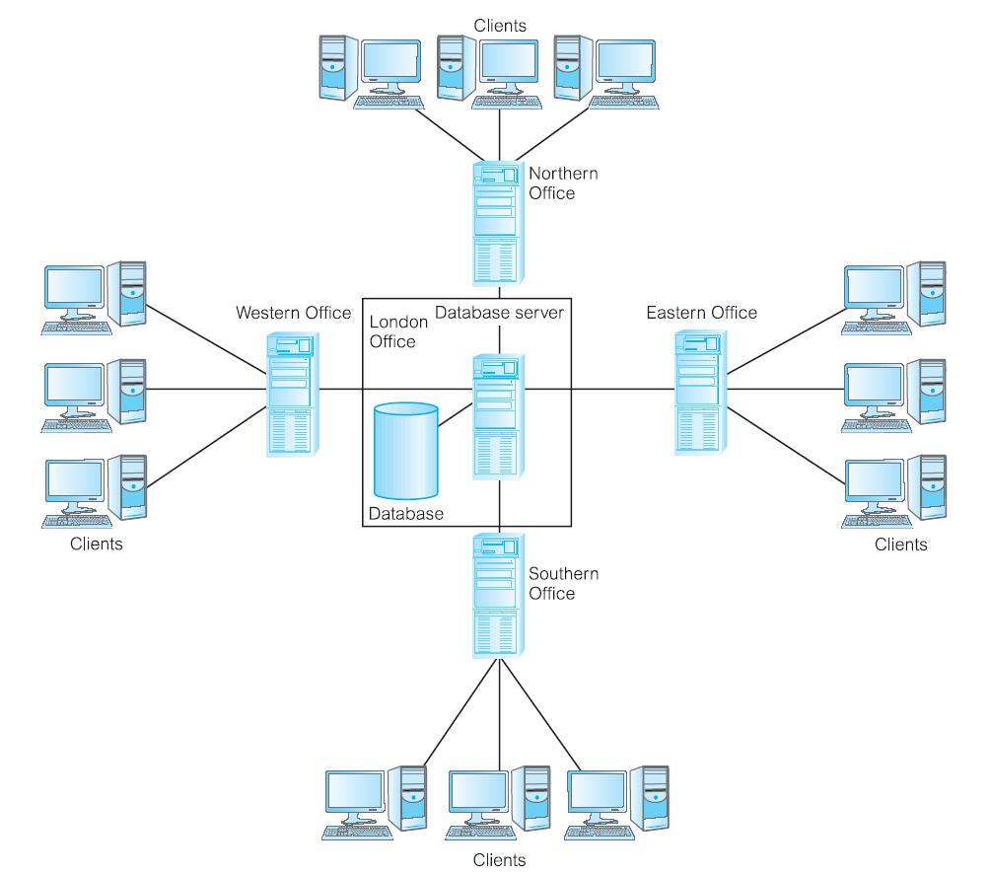
Components of the DBMS Environment
1. Hardware

Slide 18
Components of the DBMS Environment
2. Software
The software component comprises the DBMS software itself and the application programs, together with the operating system, including network software if the DBMS is being used over a network.
Typically, application programs are written in a third-generation programming language (3GL), such as C, C++, C#, Java, Visual Basic, COBOL, Fortran, Ada, or Pascal, or a fourth-generation language (4GL), such as SQL, embedded in a third-generation language.

Slide 19
Components of the DBMS Environment
3. Data
Data is the most important component of the DBMS environment.
4. Procedure
Procedures refer to the instructions and rules that govern the design and use of the database.
5. People
The final component is the people involved with the system.

Slide 20
Database Design: The Paradigm Shift
The structure of the database is determined during database design.
File-based systems, where the work was driven by the application needs of individual departments.
Database approach : the data first and the application second.

Slide 21
Roles in the Database environment
Four distinct types of people in the DBMS environment:
data and database administrators
database designers
application developers
end-users.

Slide 22
Data and Database Administrators
Data Administrator (DA) is responsible for the management of the data resource, including database planning; development and maintenance of standards, policies and procedures; and conceptual/logical database design.
The Database Administrator (DBA) is responsible for the physical realization of the database, including physical database design and implementation, security and integrity control, maintenance of the operational system, and ensuring satisfactory performance of the applications for users.

Slide 23
Database Designers
Two types of database designer:
Logical database designers
Concerned with identifying the data, the relationships between the data, and the constraints on the data that is to be stored in the database.
2. Physical database designers
Decides how the logical database design is to be physically realized. This involves:
mapping the logical database design into a set of tables and integrity constraints;
selecting specific storage structures and access methods for the data to achieve good performance;
designing any security measures required on the data.

Slide 24
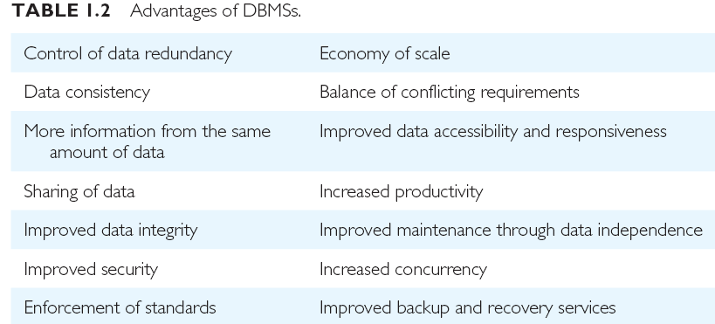
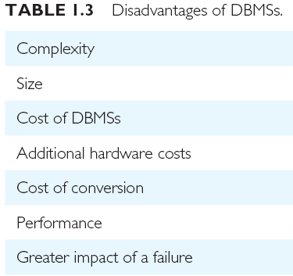

Slide 25
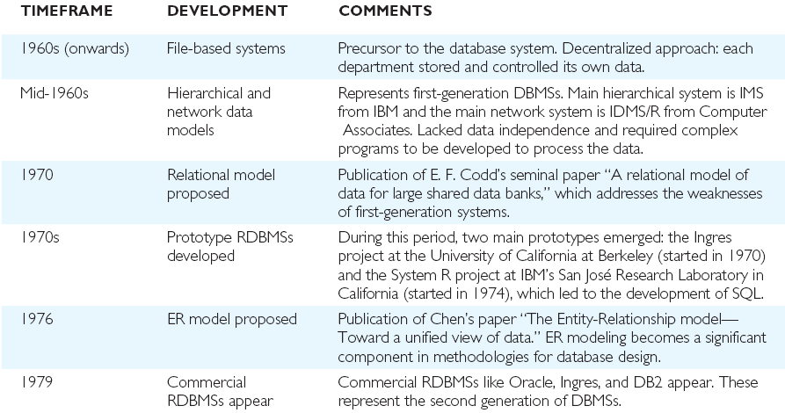
History

Slide 26
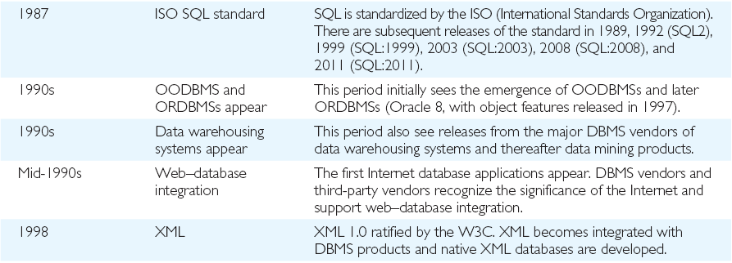
History (Cont’d)

