Slide 1
Selamat Datang di “Programming Essentials in Python”
Instruktur: Hendi Hermawan, S.T., M.T.I.
hendiananta@gmail.com / 085710098205

Slide 2
Profil Hendi Hermawan, S.T., M.T.I.
hendiananta@gmail.com / 085710098205
Dosen:
Teknik Informatika, UMB, 2004-2010
Multimedia, STDI Interstudi, 2010-2014
Teknik Informatika, STTI NIIT I-Tech, 2005-2014
Teknik Informatika, Univ. Pembangunan Jaya, 2014-skg
Instruktur Cisco Academy Indonesia
Founder depokhosting.com

Slide 3
Data Types. Variables, Basic Input-Output Operations, basic Operators
Modul 2

Slide 4
In this module, you will learn about:
Data types and the basic methods of formatting, converting, inputting and outputting data;
Operators;
Variables

Slide 5
Hello World!
It's time to start writing some real, working Python code. It'll be very simple for the time being, just type the code below in the editor:
print(“Hello, World!”)
As you can see, the first program consists of the following parts:
the word print;
an opening parenthesis;
a quotation mark;
a line of text: Hello, World!;
another quotation mark;
a closing parenthesis.

Slide 6
The print() function
Look at the line of code beside:
The word print that you can see here is a function name.
That doesn't mean that wherever the word appears it is always a function name.
The meaning of the word comes from the context in which the word has been used.
You've probably encountered the term function many times before, during math classes.
You can probably also list several names of mathematical functions, like sine or log.
print(“Hello, World!”)

Slide 7
The print() function
Where do the functions come from?
They may come from Python itself / built-in
The print function is one of this kind
you don't have to do anything special (e.g., ask anyone for anything) if you want to make use of it;
They may come from one or more of Python's add-ons named modules;
some of the modules come with Python, others may require separate installation - whatever the case, they all need to be explicitly connected with your
you can write them yourself, placing as many functions as you want and need inside your program to make it simpler, clearer and more elegant.

Slide 8
The print() function
A function (in this context) is a separate part of the computer code able to:
Cause some effect (e.g., send text to the terminal, create a file, draw an image, play a sound, etc.); this is something completely unheard of in the world of mathematics;
evaluate a value or some values (e.g., the square root of a value or the length of a given text); this is what makes Python's functions the relatives of mathematical concepts.
There's also a third, very important, function component - the argument(s).
Mathematical functions usually take one argument, e.g., sin(x) takes an x, which is the measure of an angle.

Slide 9
The print() function
Python functions, on the other hand, are more versatile.
Depending on the individual needs, they may accept any number of arguments - as many as necessary to perform their tasks.
Some Python functions don't need any argument.
In spite of the number of needed/provided arguments, Python functions strongly demand the presence of a pair of parentheses - opening and closing ones, respectively.
If you want to deliver one or more arguments to a function, you place them inside the parentheses. If you're going to use a function which doesn't take any argument, you still have to have the parentheses.

Slide 10
The print() function
The only argument delivered to the print() function in this example is a string:
As you can see, the string is delimited with quotes - in fact, the quotes make the string - they cut out a part of the code and assign a different meaning to it.
print(“Hello, World!”)

Slide 11
The print() function - LAB 2.1.1.7
Estimated time: 5 minutes
Level of difficulty: Very easy
Objectives:
becoming familiar with the print() function and its formatting capabilities;
experimenting with Python code.
Scenario
The print() command, which is one of the easiest directives in Python, simply prints out a line to the screen.

Slide 12
The print() function - LAB 2.1.1.7
In your first lab:
use the print() function to print the line Hello, Python! to the screen. Use double quotes around the string;
having done that, use the print() function again, but this time print your first name;
remove the double quotes and run your code. Watch Python's reaction. What kind of error is thrown?
then, remove the parentheses, put back the double quotes, and run your code again. What kind of error is thrown this time?
experiment as much as you can. Change double quotes to single quotes, use multiple print() functions on the same line, and then on different lines. See what happens.

Slide 13
The print() function
Three important questions have to be answered as soon as possible:
1. What is the effect the print() function causes?
The effect is very useful and very spectacular. The function:
takes its arguments (it may accept more than one argument and may also accept less than one argument)
converts them into human-readable form if needed (as you may suspect, strings don't require this action, as the string is already readable)
and sends the resulting data to the output device (usually the console); in other words, anything you put into the print() function will appear on your screen.

Slide 14
The print() function
2. What arguments does print() expect?
Any. We'll show you soon that print() is able to operate with virtually all types of data offered by Python.
Strings, numbers, characters, logical values, objects - any of these may be successfully passed to print().
3. What value does the print() function evaluate?
None. Its effect is enough - print() does not evaluate anything.

Slide 15
The print() function - instructions
Python requires that there cannot be more than one instruction in a line.
A line can be empty (i.e., it may contain no instruction at all) but it must not contain two, three or more instructions.
This is strictly prohibited.
Type the following code in your editor, then run it:
Output:

Slide 16
The print() function - instructions
we've added one empty print() function invocation.
We call it empty because we haven't delivered any arguments to the function.
Type the following code in your editor, then run it:
Output:

Slide 17
The print() function – the escape and newline characters
There are two very subtle changes - we've inserted a strange pair of characters inside the rhyme. They look like this: \n.
Type the following code in your editor, then run it:
Output:

Slide 18
The print() function – the escape and newline characters
Type the following code in your editor, then run it:
Output:
Type the following code in your editor, then run it:
Output:

Slide 19
The print() function - using multiple arguments
Type the following code in your editor, then run it:
There is one print() function invocation, but it contains three arguments.
All of them are strings.
The arguments are separated by commas
Output:

Slide 20
The print() function - the positional way of passing the arguments
Type the following code in your editor, then run it:
Output:
The way in which we are passing the arguments into the print() function is the most common in Python, and is called the positional way

Slide 21
The print() function - the keyword arguments
The print() function has two keyword arguments that you can use for your purposes:
end
determines the characters the print() function sends to the output once it reaches the end of its positional arguments
Sep
defines the separator between the arguments or items in an iterator to print
Python 3 sep defaults to “space” which is known as “soft spacing”

Slide 22
The print() function - the keyword arguments
Type the following code in your editor, then run it:
Output:
The default behavior reflects the situation where the end keyword argument is implicitly used in the following way:

Slide 23
The print() function - the keyword arguments
Type the following code in your editor, then run it:
Output:

Slide 24
The print() function - the keyword arguments
Both keyword arguments may be mixed in one invocation, just like here in the editor window.
Type the following code in your editor, then run it:
Output:

Slide 25
The print() function - LAB 2.1.1.19
Estimated time: 5 minutes
Level of difficulty: Very Easy
Objectives: becoming familiar with the print() function and its formatting capabilities; experimenting with Python code.
Scenario
Modify the first line of code in the editor, using the sep and end keywords, to match the expected output. Use the two print() functions in the editor.
Don't change anything in the second print() invocation.
Expected output:

Slide 26
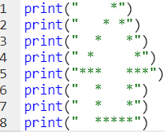
The print() function - LAB 2.1.1.20
Estimated time: 5 minutes
Level of difficulty: Very Easy
Objectives:
experimenting with existing Python code,
discovering and fixing basic syntax errors,
becoming familiar with the print() function and its formatting capabilities.
Scenario
We strongly encourage you to play with the code we've written for you, and make some (maybe even destructive) amendments. Feel free to modify any part of the code, but there is one condition - learn from your mistakes and draw your own conclusions.

Slide 27
The print() function - LAB 2.1.1.20
Try to:
minimize the number of print() function invocations by inserting the \n sequence into the strings
make the arrow twice as large (but keep the proportions)
duplicate the arrow, placing both arrows side by side; note: a string may be multiplied by using the following trick: "string" * 2 will produce "stringstring" (we'll tell you more about it soon)
remove any of the quotes, and look carefully at Python's response; pay attention to where Python sees an error - is this the place where the error really exists?
do the same with some of the parentheses;
change any of the print words into something else, differing only in case (e.g., Print) - what happens now?
replace some of the quotes with apostrophes; watch what happens carefully.

Slide 28
Literals - the data in itself
A literal is data whose values are determined by the literal itself.
Example:
123 ➔ literal (integer literal)
C ➔ not literal
“2” ➔ literal (string literal)
2.5 ➔ literal (float literal)

Slide 29
Integer
a number that can be written without a fractional component
Example:
print(123), output: 123
print(11_111), output: 11111
print(+75000), output: 75000

Slide 30
Integer:octal and hexadecimal numbers
Octal
an integer number is preceded by an 0O or 0o prefix (zero-o)
This means that the number must contain digits taken from the [0..7] range only.
Example:
0o123 is an octal number with a (decimal) value equal to 83
Hexadecimal
An integer numbers is be preceded by the prefix 0x or 0X (zero-x)
Example:
0x123 is a hexadecimal number with a (decimal) value equal to 291
print(0x123), output: 291

Slide 31
Float
The numbers that have (or may have) a fractional part after the decimal point
Example:
print(2.5), output: 2.5
print(-0.4), output: -0.4
print(.4), output: 0.4
print(4.), output: 4.0

Slide 32
You can use scientific notation
When you want to use any numbers that are very large or very small
for example, the speed of light, expressed in meters per second. Written directly it would look like this: 300000000.
To avoid writing out so many zeros, physics textbooks use an abbreviated form, which you have probably already seen: 3 x 10⁸.
In Python, the same effect is achieved in a slightly different way - take a look: 3E8 or 3e8
Note:
the exponent (the value after the E) has to be an integer;
the base (the value in front of the E) may be an integer.

Slide 33
You can use scientific notation
A physical constant called Planck's constant (and denoted as h), according to the textbooks, has the value of: 6.62607 x 10⁻³⁴.
If you would like to use it in a program, you should write it this way: 6.62607E-34
Note: the fact that you've chosen one of the possible forms of coding float values doesn't mean that Python will present it the same way.
Python may sometimes choose different notation than you.
For example, let's say you've decided to use the following float literal: 0.0000000000000000000001
When you run this literal through Python: print(0.0000000000000000000001)
this is the result: 1e-22

Slide 34
Strings
Strings are used when you need to process text (like names of all kinds, addresses, novels, etc.), not numbers.
Example:
print("Hello")
print('Hello')
print(
"""
+================================+
| Welcome to my game, muggle! |
| Enter an integer number |
| and guess what number I've |
| picked for you. |
| So, what is the secret number? |
+================================+
""")
print("I like \"Monty Python\""), output: I like "Monty Python“
print('I like "Monty Python"'), output: I like "Monty Python“

Slide 35
Boolean Value
These two Boolean values have strict denotations in Python:
True
False

Slide 36
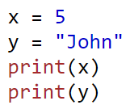
Variables
Creating Variables
Variables are containers for storing data values.
Unlike other programming languages, Python has no command for declaring a variable.
A variable is created the moment you first assign a value to it.
Example:
Output:

Slide 37
Variables
Variables do not need to be declared with any particular type and can even change type after they have been set, example:
Output:
String variables can be declared either by using single or double quotes, example:

Slide 38
Variables
String variables can be declared either by using single or double quotes, example:
Output:

Slide 39
Variables
A variable can have a short name (like x and y) or a more descriptive name (age, carname, total_volume). Rules for Python variables:
A variable name must start with a letter or the underscore character
A variable name cannot start with a number
A variable name can only contain alpha-numeric characters and underscores (A-z, 0-9, and _ )
Variable names are case-sensitive (age, Age and AGE are three different variables)

Slide 40
Arithmetic Operators
Arithmetic operators are used with numeric values to perform common mathematical operations:
Operator | Name | Example | Output
+ | Addition | print(2 + 2) | 4
- | Subtraction | print(5 – 2) | 3
* | Multiplication | print(5 * 2) | 10
/ | Division | print(6 / 2) | 3
% | Modulus | print(7 % 2) | 1
** | Exponentiation | print(2 ** 3) | 8
// | Floor division | print(7 // 2) | 3

Slide 41
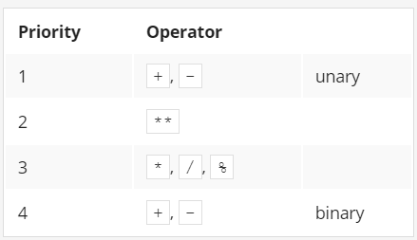
Arithmetic Operators
Most of Python's operators have left-sided binding, which means that the calculation of the expression is conducted from left to right. Except: exponentiation, example:
print(2 ** 2 ** 3), output: 256
Calculation: 2 ** 3 → 8; 2 ** 8 → 256
List of priorities

Slide 42
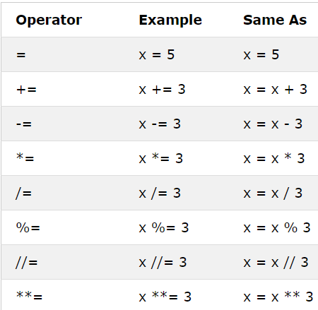
Assignment Operators
Assignment operators are used to assign values to variables

Slide 43
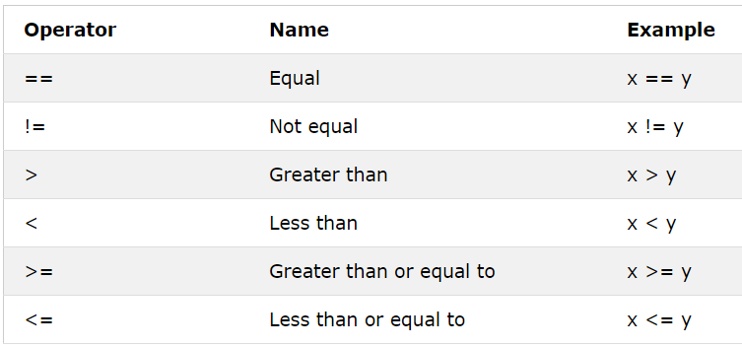
Comparison Operators
Comparison operators are used to compare two values

Slide 44
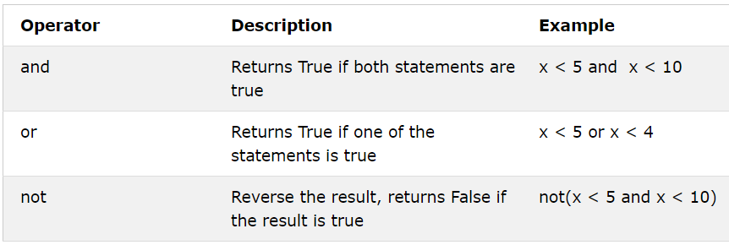
Logical Operators
Logical operators are used to combine conditional statements

Slide 45
Comment
Comments can be used to explain Python code.
Comments can be used to make the code more readable.
Comments can be used to prevent execution when testing code.
Comments starts with a #, and Python will ignore them, example:
Output:

Slide 46
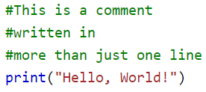
Comment – multi line
Python does not really have a syntax for multi line comments.
To add a multiline comment you could insert a # for each line, example:

Slide 47
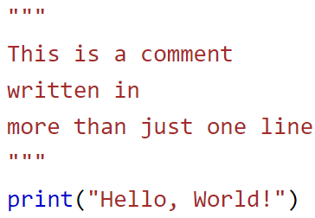
Comment – multi line
Or, not quite as intended, you can use a multiline string.
Since Python will ignore string literals that are not assigned to a variable, you can add a multiline string (triple quotes) in your code, and place you comment inside it:
As long as the string is not assigned to a variable, Python will read the code, but then ignore it, and you have made a multiline comment.

Slide 48
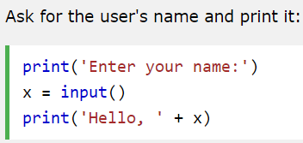
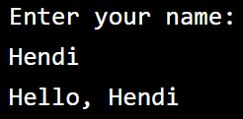
Python input() Function
The input() function allows user input, example:
Output:

Slide 49
Type casting
There may be times when you want to specify a type on to a variable.
This can be done with casting.
Python is an object-orientated language, and as such it uses classes to define data types, including its primitive types.
Casting in python is therefore done using constructor functions:
int() - constructs an integer number from an integer literal, a float literal (by rounding down to the previous whole number), or a string literal (providing the string represents a whole number)
float() - constructs a float number from an integer literal, a float literal or a string literal (providing the string represents a float or an integer)
str() - constructs a string from a wide variety of data types, including strings, integer literals and float literals

Slide 50
Type casting – to Integer
Example:
Output:

Slide 51
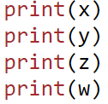
Type casting – to float
Example:
Output:

Slide 52
Type casting – to String
Example:
Output:

Slide 53
String operators - introduction
Concatenation
The + (plus) sign, when applied to two strings, becomes a concatenation operator, example:
Output:

Slide 54
String operators - introduction
Replication
The * (asterisk) sign, when applied to a string and number (or a number and string, as it remains commutative in this position) becomes a replication operator, example:
Example 2: Output:

