Slide 1
Dasar Logika Matematika
Week 2. Recognizing Fallacies

Slide 3
Session & Syllabus
Session |  | Topics | Descriptions | Lecturer
1 | 4 Sep 2014 | Introduction & Prologue |  | Dosen PJ
2 | 11 Sep 2014 | Recognizing Fallacies | Looking at deceptive arguments, or fallacies | CAN
3 | 18 Sep 2014 | Propositions and Truth Values | Proposition, Negation, Logical Connector (And, Or, If … then) | AER
4 | 25 Sep 2014 | Propositions and Truth Values | Alternative Phrasing of Conditional, Converse, Inverse, Contra Positive | AER
5 | 2 Okt 2014 | Sets and Venn Diagrams A Brief Review: Sets of Numbers | Relationship Among Sets, Categorical Propositions, Diagram Venn | CAN
6 | 9 Okt 2014 | Analyzing Arguments | 2 Types of Arguments (Inductive and Deductive), Test of Validity, Intro: Induction and Deduction in Mathematics. | MSI
7 | 16 Okt 2014 | Case Study | Critical Thinking in Everyday Life | Dosen PJ
8 | 23 Okt 2014 | Ujian Tengah Semester |  | Dosen PJ

Slide 4
Objective
To help student to Develop the quantitative reasoning skills that will need to succed in other college course, in career and in life as citizen in an increasingly complex world
Increasing the ability to approach problems in critical and analytical way
The experience of student gain by analyzing fallacies will provide a foundation upon which to build additional critical thinking skills

Slide 5
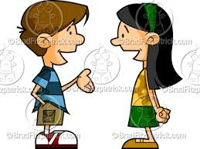
Consider the following “argument” between two classmates
Mike : the death penalty is immoral
Erica : no it isn’t
Mike : yes it is ! Judge who give the death penalty should be impeached
Erica : You don’t even know how the death penalty is decided
Mike : I know a lot more than you know !
Erica : I can’t talk to you; you’re an idiot!
This type of heated conversation is fairly common
it is likely to leave both of the upset and angry
there is a better way to argue
We can use skills of logic –the study of the methods and
Principles of reasoning-
Arguing logically may not change mike ‘s and erica’s position
but it can help the understand each other

Slide 6
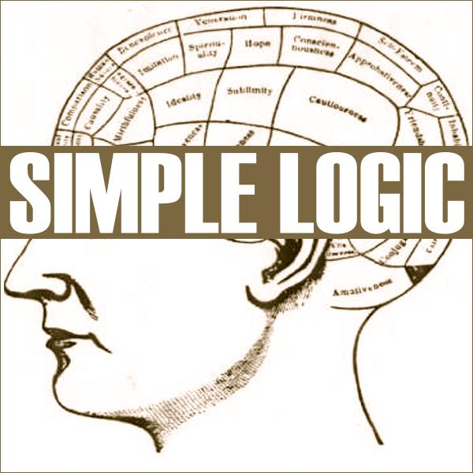
Definitions
Logic is study of the methods and principles of reasoning
It is "the science of argument."
Argument uses a set of facts or assumptions, called premises, to support Conclution
When presenting an argument, one takes a set of premises that are proven to be true, and uses logic to show how they prove a certain "foregone conclusion."
Logical errors in argument are known as fallacies
A Fallacy is a deceptive argument – an argument in which the conclusion is not well supported by the premises

Slide 7
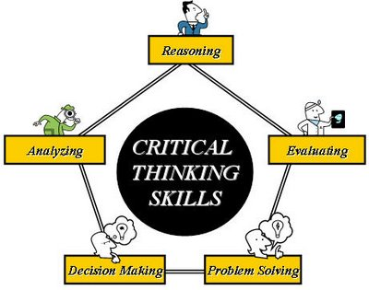
Recoginizing Fallacies in critical thinking skills
Fallacies are so common, it is important to be able recognize them.
Some fallacies are just accidental, but they can also be used to trap an unwary listener or reader into believing faulty conclusions
The experience you gain by analyzing fallacies will provide a foundation upon which to build additional critical thinking skills

Slide 8
10 types of logical fallacies
The fallacy in each example has a fancy names, but learning the names is far less important than learning to recognize the faulty reasoning. The experience you gain by analyzing fallacies will provide a foundation upon which to bulid additional critical thinking
1. Appeal to Popularity
2. False Cause
3. Appeal to Ignorance
4. Hasty Generalization
5. Limited Choice
6. Appeal to Emotion
7. Personal Attack
8. Circular Reasoning
9. Diversion (Red Herring)
10 Straw Man

Slide 9
1. Appeal to Popularity (Argumentum ad populum)
The fact that large number of people believe or act some way is used inapropriately as evidence that the belief or action is correct
  Example :
“ Ford makes the best pickup trucks in the world. After all , more people drive Ford pickups than any othe light truck”
Analysis : We identify the premises and conclusion of this argument as follows
Premise : More people drive Ford pickups than any other light truck.
Conclusion : Ford makes the best pickup trucks in the world.
The fact that more people drive Ford pickups does not necessary mean that they are the best trucks. This argument suffers from the fallacy of Appeal to Popularity
Check the fallacy of this :
  "Coke is the favorite soda of 9 out of 10 actors, therefore we should have Coke at our picnic”
  “Pasti diirektur bank xyz selingkuh karena dari hasil survey majalah eksekutif menunjukan dua dari tiga pria eksekutive selingkuh”
  Saya yakin pepsodent pasta gigi yg terbaik karena mayoritas penduduk jakarta menggunakannya“
Many people believe P is true
Therefore
P is true

Slide 10
2. False Cause (Post Hoc Ergo Propter Hoc )
Assuming that one event is caused by another, just because one happens after the other, is the fallacy of false cause. The two events could have both been caused by another event, or they could be totally unrelated.
“ I placed the quartz crystal on my forehead, and in five minute my headache was gone, the crystal made my headache go away”
Analysis : We identify the premises and conclusion of this argument as follows
Premise : I placed the quarts crystal on my forehead.
Premise : Five minute later my headache was gone.
Conclusion : The crystal made my headache go away
The premises tell us that one thing (crystal on forehead) happened before another (headache went away) , but they don’t prove any connection between them. That is we cannot conclude that the cystal caused the headache to go away. This argument suffers from the fallacy of false cause
Check the fallacy of this :
  "More people die in hospitals than anywhere else. Therefore, going to a hospital causes death “
  “During the past two months, every time the cheerleaders have worn blue ribbons, the basketball team has won. So if we want to keep winning, they had better continue to wear the blue ribbons.”
A came before B
Therefore
A caused B

Slide 11
3. Appeal to Ignorance (argumentum ad ignorantiam)
Appeal to ignorance (Latin: argumentum ad ignorantiam), (in which ignorance stands for "lack of evidence to the contrary"), it asserts that a proposition is true because it has not yet been proven false (or vice versa)
Example :
“Scientist have not found any concrete evidence of aliens visiting Earth. Therefore, anyone who claims to have seen a UFO must be hallucinating.”
Analysis : We identify the premises and conclusion of this argument as follows
Premise : There’s no proof that aliens have visited Earth.
Conclusion : Aliens have not visited Earth
The Fallacy should be clear : A Lack of proof of alien visits does not mean that visits have not accured. This fallacy is called appeal to ignorance
Check the fallacy of this :
  “Sampai saat ini Tidak ada yang pernah melihat Tuhan adalah bukti tidak adanya tuhan “
There is no proof that p is true
P is false

Slide 12
4. Hasty Generalization
A hasty generalization is a general rule that is formed from only a few examples, or examples that are really exceptions.
“Two cases of childhood leukemia have occurred along the street where the high-voltage power lines run. The power lines must be the cause of these illneses”
Premise : Two cases of childhood leukemia have occurred along the street where the high-voltage power lines run.
Conclusion : The power lines must be the cause of leukemia
Analysis : The premises of this argument cites two cases in which leukemia occurred on the street with the power lines. But Two cases are not enough to establish a pattern, let alone to conclude that the power lines are the causes of the ilnessses. This argument suffers from the fallacy of hasty generalization
  Check the fallacy of this :
  "A bear lives at the zoo, therefore, all bears live at zoos.“
A and B are linked one or few times;
Therefore
A caused B
(or vice versa -atau sebaliknya-)

Slide 13
5. Limited Choice (False dilemma or False dichotomy)
Limited choice : Forcing a conclusion by artificially limiting the available options. Most commonly it involves an “either/or” statement
Example :
“You don’t support the President, so you are not a patriotic American”
Analysis :
Premise : You don’t support the President
Conclusion : You are not a patriotic American
The argument suggests that there are only two types of Americans: patriotic ones who support the President and unpatriotic ones who don’t. But there are many other possibilities , such as being patriotic while dislike a particular president. This argument represents the fallacy of limited choice.
  Check the fallacy of this :
  “Kamu tidak hapal pancasila, Jadi Kamu seorang Komunis”
P is false;
Therefore
Only Q can be true

Slide 14
6. Appeal to Emotion (Argumentum ad passiones)
Appeal to emotion or argumentum ad passiones is a logical fallacy which uses the manipulation of the recipient's emotions, rather than valid logic, to win an argument.
The appeal to emotion fallacy uses emotions as the basis of an argument's position without factual evidence that logically supports the major ideas endorsed by the elicitor of the argument.
Also, this kind of thinking may be evident in one who lets emotions and/or other subjective considerations influence one's reasoning process
Example :
In a commercial for Michelin tires , a picture of a baby is shown with the words “because so much is riding on your tires”
Analysis :
Premises : You love your baby
Conclution : You should buy Michelin tires
The argument makes no appeal to logic, This attempt to evoke an emotional response as a tool of persuasion. This argument represents the fallacy of appeal to emotion.
  Check the fallacy of this :
  “Keputusan dari AA Gym untuk memilih calon presiden itu pasti benar mesti kita ikuti , Aa Gym kan seorang ulama terkenal“
P is associated with a positive emotional response;
Therefore
P is true

Slide 15
7. Personal Attack (ad Hominem)
Personal Attack or ad hominem (Latin for "to the man" or "to the person"), short for argumentum ad hominem, is a general category of fallacies in which a claim or argument is rejected on the basis of some irrelevant fact about the author of or the person presenting the claim or argument
Example :
Gwen : You should stop drinking alcohol because it’s hurting your grades, endangering people when you drink and drive
Merle : I’ve seen you drink a few too many on occasion yourself
Analysis : Merle has resorted to attacking to Gwen personally rather than arguing logically, so we call this fallacy personal attack or ad hominem
I have a problem with the person or group claiming p
Therefore
P is not true

Slide 16
8. Circular Reasoning (circulus in probando)
Circular reasoning is a logical fallacy in which the reasoner begins with what they are trying to end with. Other ways to express this are that there is no reason to accept the premises unless one already believes the conclusion, or that the premises provide no independent ground or evidence for the conclusion
Example :
“society has on obligation to shelter the homeless because the needy have a right to the resources of the community”
Analysis : the premise and conclusion both say essentially the same thing
P is true
P is restarted in different words

Slide 17
9. Diversion (Red Herring)
red herring is used to refer to something that misleads or distracts from the relevant or important issue. It may be either a logical fallacy or a literary device that leads readers or characters towards a false conclusion.
A red herring might be intentionally used, such as in mystery fiction or as part of a rhetorical strategy (e.g. in politics), or it could be inadvertently used during argumentation as a result of poor logic.
Example :
"I think that we should make the academic requirements stricter for students. I recommend that you support this because we are in a budget crisis and we do not want our salaries affected.
Analysis : The second sentence, though used to support the first sentence, does not address that topic.
P is related to q and I have an argument concerning q;
Therefore
P is true

Slide 18
10. Straw Man
I have an argument concerning a disorted version of p;
Therefore
I hope you are fooled into concluding I have an argument concerning the real version of p
A straw man –manusia jerami- is a common type of argument and is an informal fallacy based on the misrepresentation of an opponent's argument. To be successful, a straw man argument requires that the audience be ignorant or uninformed of the original argument.
The so-called typical "attacking a straw man" argument creates the illusion of having completely refuted or defeated an opponent's proposition by covertly replacing it with a different proposition (i.e., "stand up a straw man") and then to refute or defeat that false argument ("knock down a straw man") instead of the original proposition.
Examples:
A: Sunny days are good.
B: If all days were sunny, we'd never have rain, and without rain, we'd have famine and death.
Analysis : In this case, B falsely frames A's claim to imply that A believes only sunny days are good, and B argues against that assertion. A actually asserts that sunny days are good and, in fact, says nothing about rainy days.

Slide 19
Exercise 1. Review Question
What is Logic ? Briefly explain how logic can be useful
How do we define argument ? What is the basic structure of an argument ?
What is a fallacy ? Why is it important to be able to recognize fallacies ?

Slide 20
Exercise 2. Basic skills & Concept
Instruction : a. Identify premise and conclusion of the stated argument
b. Explain how the fallacy occurs
c. Make up your own example of another argument that suffer from the same fallacy
Soal
(Appeal to Popularity) Polls showed that 70% of the national TV audiens watched the last roundof American Idol, so it must be worth watching
(Limited choice) He refused to testify by pleading the fifth amendment, so he must be guilty
(circular Reasoning) Schools must implement a zero tolerance policy toward drug use, because any tolerance of drugs is unacceptable
(Diversion) We should not build more prisons, because crime has been decreasing in New York City

Slide 21
Exercise 3. Further Application
Instruction : a. Identify premise and conclusion of the stated argument
b. Explain how the fallacy occurs
c. Name the types and explain how they apply
Soal
The President raised taxes last year, so this tax increase must have been responsible for the increase in government revenue this year
There’s no proof that global warming will have bad consequences for our society , so we have no reason to be concerned about it
He may claim to have written that inspiring poem, but I would doubt it, given his alleged history of borrowing other’s work

Slide 22

Terima Kasih

