Slide 1
Jurnalisme online
Kuliah 6 (Emma R.Aliudin & Ingki Rinaldi)

Slide 2
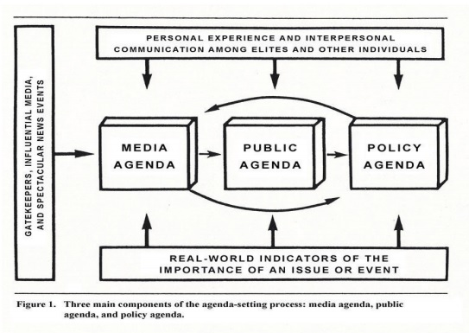
Jurnalisme Online
Agenda Setting
Rogers &Dearing in Pembayun (2015) (ejournal.undip.ac.id)

Slide 3
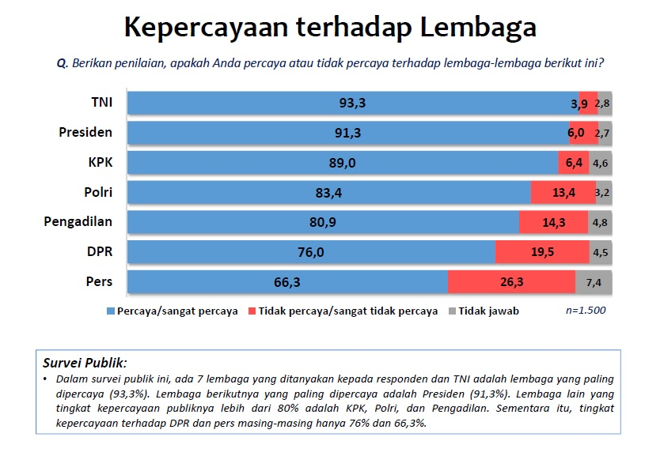
Jurnalisme Online
Konteks
(Pusat Penelitian Politik, Lembaga Ilmu Pengetahuan Indonesia. 2019)

Slide 4
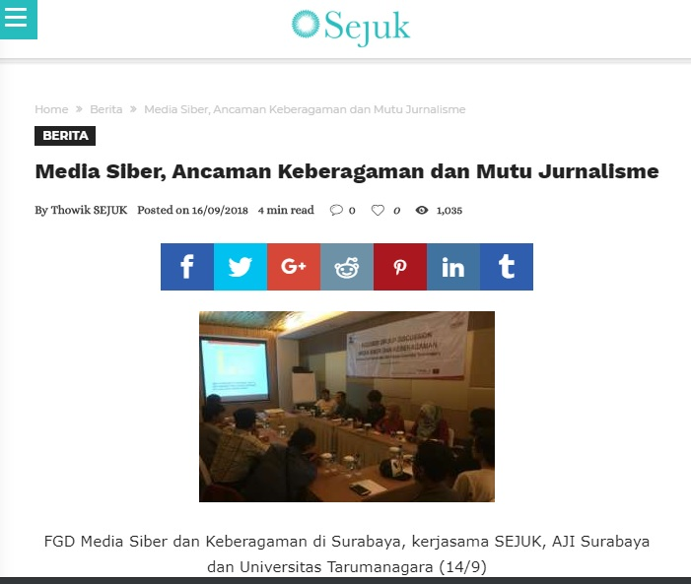
Jurnalisme Online
Konteks
sejuk.org

Slide 5
Jurnalisme Online
Agenda Setting
Agenda-setting theory also describes how media coverage affects public
opinion. Merely by publishing some stories and not others, the media set the
agenda—or topic of conversation—for what people probably will and won’t
be discussing that day. (Joseph Straubhaar, Robert LaRose, Lucinda Davenport, 2012)

Slide 6
Jurnalisme Online
Framing
Whereas the media’s agenda setting tells us what topics to think about, the framing of issues tells us how to think about those topics. Framing theory examines how writers frame or present a story (Altheide, 1974; Gitlin, 1983). Reporters decide what to include within the view, or frame, of a story and what to leave out, much as a painter chooses what to put on the canvas of a painting. They decide which tone, words, and facts to include, but also the conceptual framework, context, and interpretation of the facts. (Joseph Straubhaar, Robert LaRose, Lucinda Davenport, 2012)

Slide 7
Jurnalisme Online
Priming
Priming theory states that media images stimulate related thoughts in the minds of audience members. (Joseph Straubhaar, Robert LaRose, Lucinda Davenport, 2012)

Slide 8
Jurnalisme Online
Agenda-Setting
The journalisms enabled by the web are driven by an agenda-setting
radically different from the corporate and statal gatekeeping of the
age of mass media, through which the information society is articulating
the values that will premise its emerging institutions. (Jim Hall, 2001)

Slide 9
Jurnalisme Online
Agenda-Setting
Ultimately, modes of user interactivity seem to reduce the amount
of control retained by the news producer. That control, usually
manifest in news filtering and agenda setting around what is seen to
be in the public interest, now accrues largely to the consumer and
this, more than its new media forms or the latest technology, is what
makes the web unique as a news carrier and holds out the greatest
promise for the future. News still reaches its consumers in mediated
forms but that mediation is increasingly removed from the hands of
(at least) local politicians and the corporations they legislate on
behalf of, entailing the unlamented loss of so-called ‘family values’
and the blind spots that arise when news becomes a commodity. (Jim Hall, 2001)

Slide 10
Jurnalisme Online
Agenda Setting di Era Masyarakat Informasi
Scott L Althaus dan David Tweksburry (2002) menguji pada Online Newspaper atau News Portal New York Times dan New York Times versi cetak. Penelitian tersebut memperlihatkan bahwa masing-masing media memiliki efek agenda setting pada masing-masing publiknya, dimana media dan publik
Yu dan Aikat (2005) menemukan bahwa Agenda Setting masih dapat diaplikasikan pada Internet (media Online). Yu dan Aikat meneliti New York Times dan Washington Post sebagai wakil dari surat kabar online/ Online Newspaper. CNN dan MSNBC untuk TV Online, dan Yahoo News dan Google News sebagai layanan berita onlinememiliki porsi atensi yang sama terhadap isu-isu.
Coleman dan Mc Combs (2007) menemukan bahwa saat efek Agenda Setting diaplikasikan pada media online pada pengguna Internet yang kebanyakan kaum muda, hasilnya signifkan. Mereka menyimpulkan bahwa penggunaan Internet tidak menghilangkan relevansi teori Agenda Setting. (Kharisma Nasionalita dalam Makna, Vol. 5 no. 2, Agustus 2014-Januari 2015)

Slide 11
Jurnalisme online
News Value
(1) criteria that relate to the occurrence of the event (the
when and where for example); (2) criteria that are about the nature of the
event itself, that is what events are considered newsworthy; and (3) criteria
which might be said to be about the treatment of the events. (Johan Galtung and Mari Ruge in (Anna McKane, 2006)
(Magnitude, Significance, Impact, Actuality/Timeliness, Proximity, Prominence, Conflict, Human Interest, Unusualness/Odd, Sex)

Slide 12
Jurnalisme online
News Value (revisited)
Yes, the public has an active role to play in the basic process of gathering news – but
this is not something new, it was ever thus. It is simply that the blog and email
have replaced traditional readers’ letters as the mechanism for the public to
inform editors of their feelings. And along with that role of public contribution
comes the requirement that the content will be checked for validity and
reliability, shaped, contextualised and eventually turned into something that is
of value and significance to all who read or watch or listen to it. Otherwise it
is not as valuable as the contributors might consider it to be. (Paul Brighton & Dennis Foy, 2007)

Slide 13
Jurnalisme online
News Value (revisited)
But this revision of the news value system is concerned with more than just
citizen journalism. The system of rolling news is here to stay – both in broadcast
and online/print media – and this has brought with it its own problems.
The need to constantly tweak and layer news stories can, as our analysis of
the Litvinenko saga proves, lead to a dropping of standards, to the seizing on
of rumour and suggestion and its metamorphosis into ‘fact’ – only for some of those ‘facts’ to be exposed as nothing of the sort shortly afterwards. This is a
worrying trend, one which can lead to further erosion of the already-limited
trust that some members of the public place in journalists; (Paul Brighton & Dennis Foy, 2007)

Slide 14
Jurnalisme online
Kaidah Jurnalistik
10 Elemen Jurnalisme
1. Kewajiban pertama Jurnalisme adalah pada kebenaran
2. Loyalitas pertama jurnalisme adalah kepada warga (citizen)
3. Esensi jurnalisme adalah disiplin verifikasi
4. Jurnalis harus tetap independen dari pihak yang mereka liput
5. Jurnalis harus melayani sebagai pemantau independen terhadap kekuasaan
6. Jurnalisme harus menyediakan forum bagi kritik maupun komentar dari publik
7. Jurnalisme harus berupaya membuat hal yang penting itu menarik dan relevan
8. Jurnalis harus menjaga agar beritanya komprehensif dan proporsional
9. Jurnalis memiliki kewajiban untuk mengikuti suara nurani mereka
10. Warga memiliki hak dan tanggung jawab dalam hal-hal yang terkait dengan berita (Bill Kovach & Tom Rosenstiel, 2014)

Slide 15
Jurnalisme online
Pertimbangan Menentukan Agenda Setting
Persepsi
Perspektif Mulltikulturalisme
Ragam Pola Budaya

Slide 16
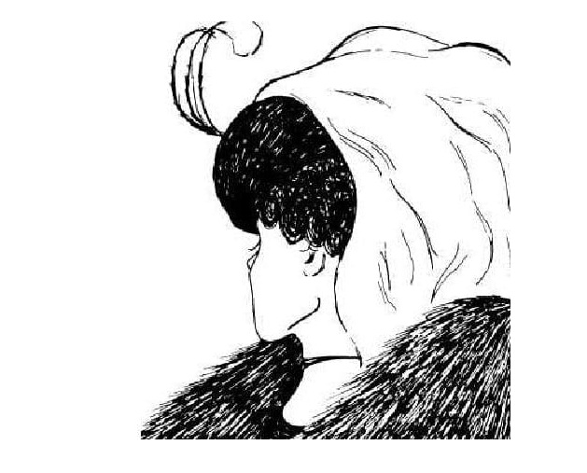
Jurnalisme online
Persepsi
twentytwowords.com

Slide 17
Jurnalisme online
Ragam Pola Budaya
To help reduce this complexity, the expression cultural patterns, sometimes called value orientations, is used as an umbrella term to collectively talk about values, beliefs, and other orientations that characterize the dominant group within a culture.
Saat menggunakan “cultural patterns,” ingatlah:
You are more than your culture
Cultural patterns are integrated
Cultural patterns are dynamic
Cultural patterns can be contradictory (Samovar, Porter, McDaniel, Roy, 2007)

Slide 18
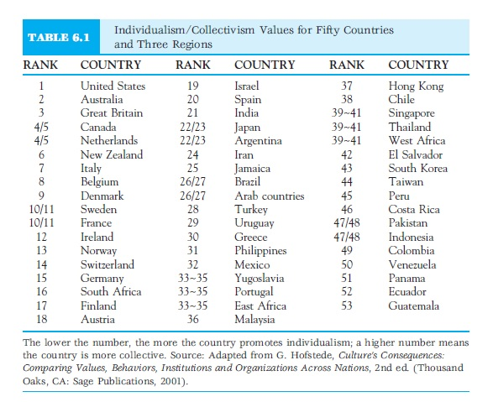
Jurnalisme online
Hofstede’s set of Value Dimensions
Samovar, Porter, McDaniel, Roy, 2007)

Slide 19
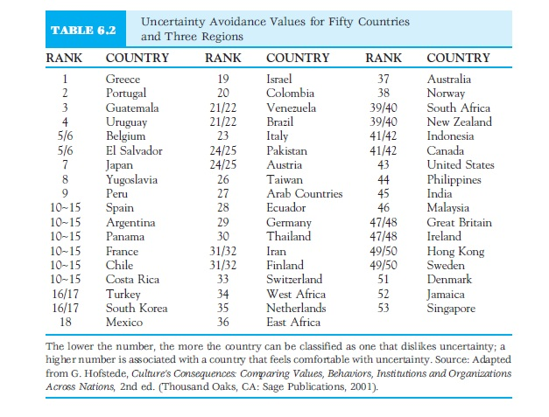
Jurnalisme online
Samovar, Porter, McDaniel, Roy, 2007)

Slide 20
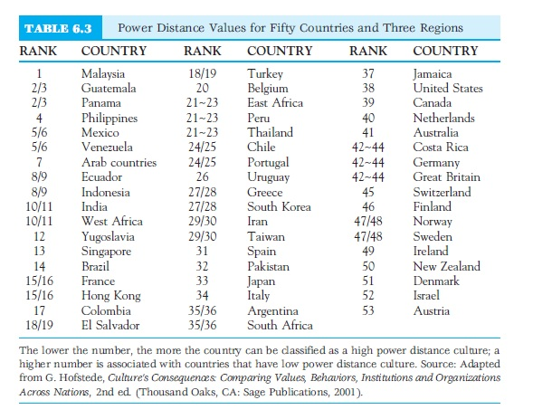
Jurnalisme online
Samovar, Porter, McDaniel, Roy, 2007)

Slide 21
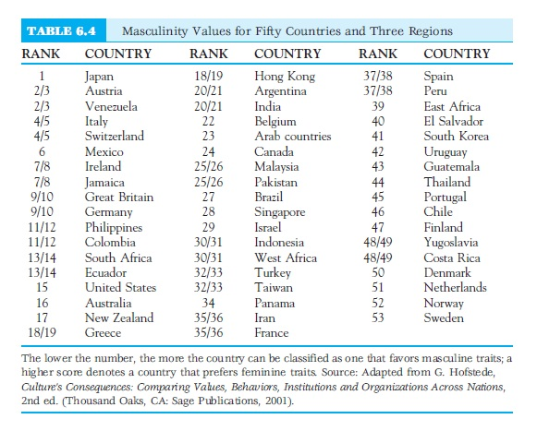
Jurnalisme online
Samovar, Porter, McDaniel, Roy, 2007)

Slide 22
Jurnalisme online
LONG- AND SHORT-TERM ORIENTATION
“China and other East Asian countries tended to score high on the dimension, suggesting a long-term orientation. Continental European countries had average scores, whereas Anglo, African, and South Asian countries had low scores, suggestive of a short-term orientation”
Samovar, Porter, McDaniel, Roy, 2007)

Slide 23
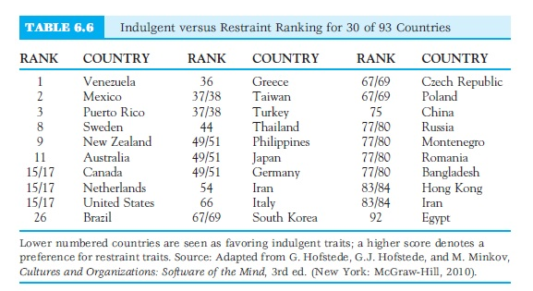
Jurnalisme online
Samovar, Porter, McDaniel, Roy, 2007)

Slide 24
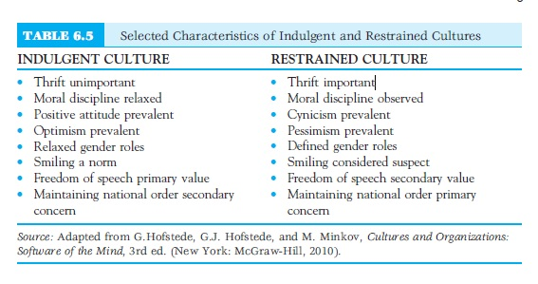
Jurnalisme online
Samovar, Porter, McDaniel, Roy, 2007)

Slide 25
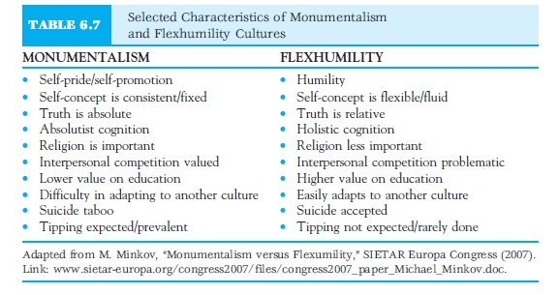
Jurnalisme online
MINKOV’S MONUMENTALISM/FLEXHUMILITY
Samovar, Porter, McDaniel, Roy, 2007)

Slide 26
Jurnalisme online
MINKOV’S MONUMENTALISM/FLEXHUMILITY
Latin American and Middle East countries scored the highest on the monumentalism
scale. At the lower end, indicating a flexhumility culture, were Slavic countries (e.g.,
Russia, Bulgaria, Ukraine, Belarus), the Baltic states (Estonia, Latvia, and Lithuania),
and Northeast Asia nations (China, Japan, and South Korea). The U.S. ranked in the
upper middle of the scale, which reflects how U.S. Americans balance self-promotion
and humbleness. In the United States, individuals are often told “you have to toot
your own horn,” meaning some degree of self-promotion is required and expected. If
that horn is tooted too loud, however, a person risks being labeled a braggart. Consider
the potential for intercultural communication failure when a monumentalism interviewer
asks a flexhumility interviewee to talk about personal achievements.
Samovar, Porter, McDaniel, Roy, 2007)

Slide 27
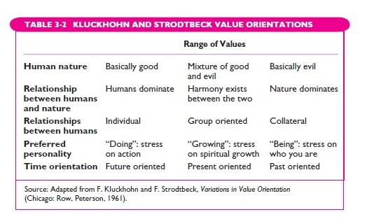
Jurnalisme online
(Martin & Nakayama, 2010)

Slide 28
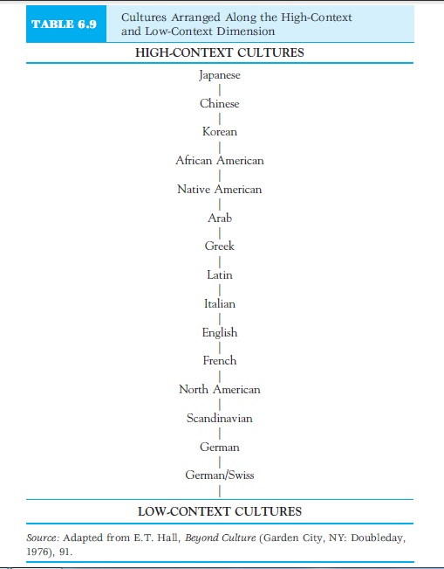
Jurnalisme online
Hall’s categorization of High-Context and Low-Context Orientations

Slide 29
Jurnalisme online
Daftar Pustaka
Quinn, Stephen., Lamble, Stephen. 2007. Online News Gathering: Research and Reporting for Journalism. Elsevier.
Hall, Jim. 2001. Online Journalism: A Critical Primer. Pluto Press.
Jenkins, Henry. 2006. Convergence Culture: Where Old and New Media Collide. New York University Press.
Straubhaar, J., LaRose, R., Davenport. 2012. Media Now: Understanding Media, Culture and Technology. 5th Ed. Update. Thomson.
Ward, Mike. 2002. Journalism Online. Focal Press.
Bradshaw, Paul., Rohumaa, Liisa. 2013. The Online Journalism Handbook: Skills to Survive and Thrive in the Digital Age. Routledge.
Tapscott, Don. 2015. The Digital Economy: Rethinking Promise And Peril In The Age Of Networked Intelligence. McGraw Hill.
McLuhan, Marshall. 1994. Understanding Media: The Extensions of Man. The MIT Press.
Pacey, Arnold. 2000. The Culture of Technology. The MIT Press.
de Sola Pool, Ithiel. 1983. Technologies of Freedom. Harvard University Press.

