Slide 1
Jurnalisme online
Kuliah 2 (Emma R.Aliudin & Ingki Rinaldi)

Slide 2
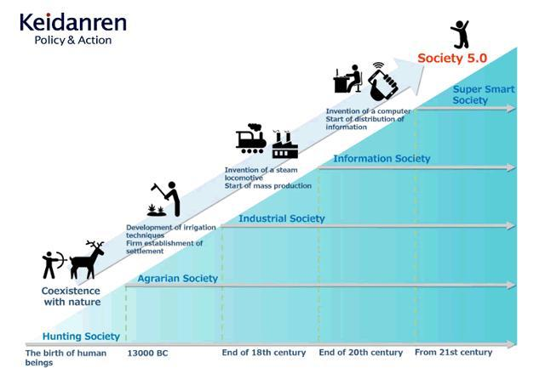
Jurnalisme online
Konteks

Slide 3
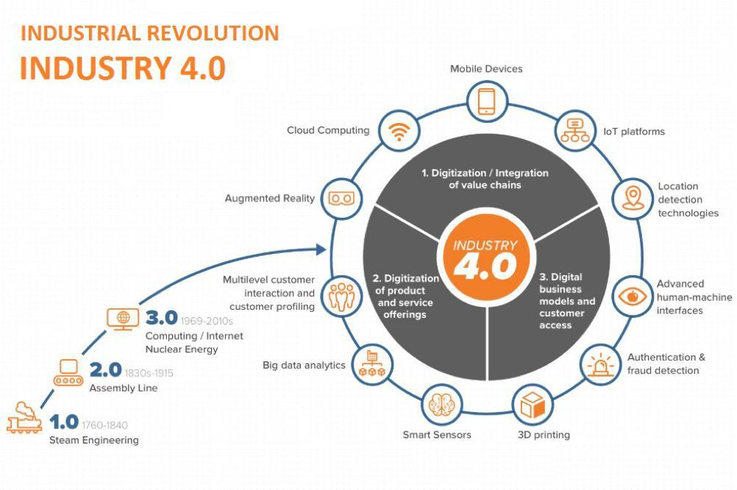
Jurnalisme online
Konteks

Slide 4
Jurnalisme online
Gelombang Ketiga Peradaban
As the Second Wave produced a mass society, the Third Wave demassifies us, moving the entire social system to a much higher level of diversity and complexity. This revolutionary process, much like the biological differentiation that occurs in evolution, helps explain one of today's most widely noted political phenomena—the collapse of consensus. From one end of the industrial world to the other we hear politicians lamenting the loss of "national purpose," the absence of the good old "Dunkirk spirit," the erosion of "national unity," and the sudden, bewildering proliferation of high-powered splinter groups. The latest buzzword in Washington is "single issue group," referring to the political organizations springing up by the thousands, usually around what each perceives as a single burning issue: abortion, gun control, gay rights, school busing, nuclear power, and so on. So diverse are these interests at both the national and local levels that politicians and officials can no longer keep track of them. (Alvin Toffler, 1984)

Slide 5
Jurnalisme online
Masyarakat Informasi
Information is a distinguishing feature of the modern world. Where once economies were built on industry and conquest, we are now part of a global information economy. Pervasive media, burgeoning information occupations and the development of the Internet convince many that living in an Information Society is the destiny of us all. Information’s presence appears evident everywhere, from daily interaction in postmodern styles to the waging of Information War, from information intensive labour to the iPOD. Coping in an era of information flows, of virtual relationships and breakneck change appears to pose challenges to one and all. (Frank Webster, 2006)

Slide 6
Jurnalisme online
Digitalisasi
pinterest.com

Slide 7
Jurnalisme online
Digitalisasi
Masa prasejarah hingga 10.000 tahun lalu => Keberadaan manusia ditentukan kondisi alam fisik, seperti gempa, gunung meletus, dan perubahan iklim. (Berburu, meramu, nomaden)
Masa 10.000 tahun terakhir => ,Keberadaan manusia menuruti alam mental. (Pertanian, menetap, kolonialisme, perang besar)
Masa 40 tahun terakhir => Keberadaan manusia ditentukan alam matematika. (Algoritma, internet, komputasi awan) (B. Sudjatmiko, 2018)

Slide 8
Jurnalisme online
Industri Baru
The overall structure of the economy was changing as well. A new industrial
sector was emerging from the convergence among computing (computers,
soft ware, services), communications (telephony, cable, satellite, wireless), and
content (entertainment, publishing, information providers). (Don Tapscott, 2015)

Slide 9
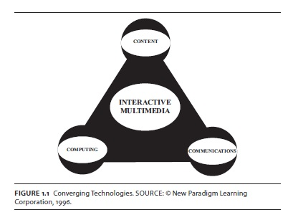
Jurnalisme online
Struktur Industri Baru
Don Tapscott, 2014

Slide 10
Jurnalisme online
Ekonomi Digital
The economy for the Age of Networked Intelligence is a digital economy. In the old economy, information fl ow was physical: cash, checks, invoices, bills of lading, reports, face-to-face meetings, analog telephone calls or radio and elevision transmissions, blueprints, maps, photographs, musical scores, and direct mail advertisements. In the new economy, information in all its forms becomes digital—reduced to bits stored in computers and racing at the speed of light across networks. Using this binary code of computers, information and communications become digital ones and zeros. The new world of possibilities thereby created is as significant as the invention of language itself, the old paradigm on which all the physically based interactions occurred. (Don Tapscott, 2014)

Slide 11
Jurnalisme online
Konsep Pokok Teknologi
In a culture like ours, long accustomed to splitting and dividing all things as a means of control, it is sometimes a bit of a shock to be reminded that, in operational and practical fact, the medium is the message. This is merely to say that the personal and social consequences of any medium—that is, of any extension of ourselves—result from the new scale that is introduced into our affairs by each extension of ourselves, or by any new technology. (Marshall McLuhan, 1964)

Slide 12
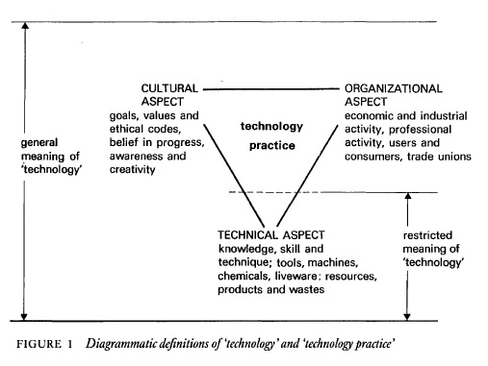
Jurnalisme online
Konsep Pokok Teknologi
Arnold Pacey, 1983

Slide 13
Jurnalisme online
Media Baru
Cetak | Penyiaran | Daring
ink to hyperlink

Slide 14
Jurnalisme online
Media Baru
The defining aspects of the new media are that they are digital, interactive, social, asynchronous, multimedia, and narrowcasted. These particular characteristics are important in distinguishing a new, audience-focused conception of the media from the older SMCR model, which emphasized the oneway transmission of messages. (Straubhaar, LaRose, Davenport, 2011)

Slide 15
Jurnalisme online
Media Now
Asynchronous Communication. Simultaneity, the notion that everyone in the audience receives the message at about the same time (or synchronously), was once another defining characteristic of the mass media. That view made sense before consumer recording technology became commonplace in the 1960s and 1970s. Before then, you had to catch a program the fi rst time it aired or wait for the reruns. However, the notion never applied very well to fi lm, not without stretching “the same time” to cover a period of several weeks. Situations that lack simultaneity are examples of
asynchronous communication. Consumers’ ability to “time shift” programs using Digital Video Recorders (DVRs) and Internet video renders the notion of simultaneity obsolete, as they can choose when to watch a program regardless of the time and day it originally airs. The television networks are now time-shifting themselves by uploading their own programs on the Internet within hours of the time of their original broadcast. Both postal mail and e-mail are two common examples of asynchronous interpersonal communication. (Straubhaar, LaRose, Davenport, 2011)

Slide 16
Jurnalisme online
Media Now
Narrowcasting. Another sign of the growing power of the audience in the new media is the practice of targeting content to smaller audiences, sometimes called narrowcasting (as opposed to broadcasting). Advanced audience research methods help the media cater to smaller audiences by enhancing the richness and speed of audience feedback. The result is that narrowcasting—dedicating communication channels to specific audience subgroups, or market segments— is now practical.
Demographic characteristics, such as sex and age, once the sole means of defi ning audiences, are being replaced by a focus on lifestyles and user needs, and even individual preferences including purchasing and online surfing behavior. Rather than homogenize audiences, the new communications media cater to specialized groups and define new niches and even customize content for individuals. (Straubhaar, LaRose, Davenport, 2011)

Slide 17
Jurnalisme online
Media Now
Social Media. Another dimension of audience power in the new media world is the ability of audiences to contribute content of their own, not merely selecting it as in our example of American Idol, but actually creating it themselves. Since this involves sharing words and images with other users in the course of social interactions, social media has emerged as an umbrella term for this phenomenon. Behind the scenes, new
technologies have made it possible to strip away the middle layers of media organizations and to shrink the minimum size of media enterprises back to that of small cottage industries and even to individual media entrepreneurs. Giant media corporations are still with us, and indeed they are getting bigger than ever, but the number of people required to turn out a media product within them is shrinking. Affordable TV cameras, audio recorders, and digital editing technology put people from all walks of life in the producer’s chair. (Straubhaar, LaRose, Davenport, 2011)

Slide 18
Jurnalisme online
Konvergensi
media convergence | participatory culture | collective intelligence.

Slide 19
Jurnalisme online
Konvergensi
A process called the "convergence of modes" is blurring the lines
between media, even between point-to-point communications, such
as the post, telephone, and telegraph, and mass communications,
such as the press, radio, and television. (Ithiel de Sola Pool, 1984)

Slide 20
Jurnalisme online
Konvergensi
Welcome to convergence culture, where old and new media collide, where grassroots and corporate media intersect, where the power of the media producer and the power of the media consumer interact in unpredictable ways. (Henry Jenkins, 2006)
In the world of media convergence, every important story gets told, every brand gets sold, and every consumer gets courted across multiple media platforms. (Henry Jenkins, 2006)

Slide 21
Jurnalisme online
Konvergensi
Welcome to convergence culture, where old and new media collide, where grassroots and corporate media intersect, where the power of the media producer and the power of the media consumer interact in unpredictable ways. (Henry Jenkins, 2006)
In the world of media convergence, every important story gets told, every brand gets sold, and every consumer gets courted across multiple media platforms. (Henry Jenkins, 2006)

Slide 22
Jurnalisme online
Konvergensi
In the world of media convergence, every important story gets told, every brand gets sold, and every consumer gets courted across multiple media platforms. (Henry Jenkins, 2006)

Slide 23
Jurnalisme online
Prinsip Media Daring
Multimedia production also brings financial benefits in the partnerships and mergers between different media companies which allow providers such as NBC News to deliver news over three media: broadcast TV, cable and, through MSNBC, the web. Thus in the age of online journalism we might add interactivity to the short list of journalistic core values. It is determined partly by the technological aspects of the medium, by its availability, but, more importantly, by changes in society including a levelling of its structural hierarchies and with the way in which we understand text. In using hypertext, or linked elements of text or information, the relationship between reader and author undergoes a shift that inverts traditional understandings of the construction of meaning and reshapes some of the values that underpin it. (Jim Hall, 2001)

Slide 24
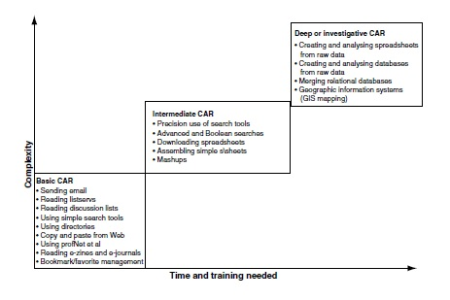
Jurnalisme online
Prinsip Media Daring
(Stephen Quinn & Stephen Lamble, 2007)

Slide 25
Jurnalisme online
Prinsip
The web arrives with surveillance
and feedback technologies, intimations of power and control, which
enable advertisers and others to target consumers personally.
Perhaps a more useful understanding of the streams of information
which now galvanise the world is through Paul Virilio and McKenzie
Wark’s ‘vector’. Information in this construction has no direction or
fixed destination and no predetermined meaning. The vector
comprises only force and, hence, effect. (Jim Hall, 2001)

Slide 26
Jurnalisme online
Prinsip
The biggest challenge facing journalists in this media age is knowing which tools to use, when. Its is not about technical skills (although access to these is always a factor), but about conceptual ones: thinking creatively about storytelling and news gathering-and, increasingly, distribution too. (Paul Bradshaw & Liisa Rohumaa, 2013)

Slide 27
Jurnalisme online
Prinsip
BASIC
BREVITY
ADAPTABILITY
SCANNABILITY
INTERACTIVITY
COMMUNITY & CONVERSATION (Paul Bradshaw)

Slide 28
Jurnalisme online
Prinsip
PROBLEM:
Kehidupan modern serbacepat
Too many things to do, so little time
Kebutuhan mendapatkan informasi segera
SOLUSI:
Informasi yang ringkas, singkat, padat
KEEP IT SHORT SIMPLE

Slide 29
Jurnalisme online
Prinsip
PROBLEM:
Info apa yang dibutuhkan?
Apa yang akan dilakukan dengan info tersebut?
SOLUSI:
Informasi harus bisa disajikan dalam berbagai format
Jurnalis harus bisa beradaptasi

Slide 30
Jurnalisme online
Prinsip
PROBLEM:
Orang membaca 25% lebih lambat di layar ketimbang di buku.
Orang scanning ketimbang membaca.
SOLUSI:
Text harus pendek, scannable, terstruktur (ada judul, intro, body), ada link. (300-700 kata)
Apa yang di-scan dari sebuah artikel?
Keyword
Kalimat yang menarik
Info tak berguna? Skip saja!

Slide 31
Jurnalisme online
Prinsip
PROBLEM:
Manusia butuh berinteraksi
Manusia butuh berbagi
SOLUSI:
Shareable options
FB, Twitter, Insta, WAG, etc
MAKE IT VIRAL!

Slide 32
Jurnalisme online
Prinsip
PROBLEM
User bukan sekadar audiens
User adalah co-Creators
User juga bertindak sebagai jurnalis
SOLUSI:
Bangun engagement
INVITE AND RESPOND

Slide 33
Jurnalisme online
Karakteristik Diseminasi Informasi
Immediacy
On the Web, there is the potential to update your news, showbiz
and any other pages simultaneously and repeatedly, minute by
minute, to give both the latest news and low-down on the pop star.
A single news site can post dozens of different updates on stories
every few minutes. Immediacy supercharged by such flexibility is
a potent tool, particularly for breaking news. However, note, again,
the word ‘potential’. (Mike Ward, 2002)

Slide 34
Jurnalisme online
Karakteristik Diseminasi Informasi
Multiple pagination
A web site can have hundred of separate pages, linked to each
other but also capable of being read and understood in isolation.
This increases the amount and range of both the news coverage
and the potential audience. (Mike Ward, 2002)

Slide 35
Jurnalisme online
Karakteristik Diseminasi Informasi
Multimedia
Web sites can offer, with varying degrees of user-friendliness,
text, audio, graphics, animated graphics, still pictures and moving
pictures. TV is king but video so far has been the Cinderella of
web publishing – or perhaps ugly sister would be a better
description. Tiny, fuzzy, jumping pictures of what you can see
anyway on television (e.g. television news reports) have belied the
web’s cutting-edge reputation. (Mike Ward, 2002)

Slide 36
Jurnalisme online
Karakteristik Diseminasi Informasi
Flexible delivery platforms
A single online news provider can take one piece of information
and put it on a web news page, include it in a searchable database
of information or send it to a mobile phone display screen. How to
‘re-purpose’ content to harness this flexibility of online delivery is
pre-occupying many news organizations at present. The economics
of re-purposing are very attractive. Gathering the information,
particularly in news, is often the expensive part. Once you have
the information, it makes sense to get it to as many people and in
as many ways as possible. It is probably the only thing
accountants and journalists agree on. (Mike Ward, 2002)

Slide 37
Jurnalisme online
Karakteristik Diseminasi Informasi
Archiving
Exploring a well-resourced web site for content is like playing a
game of three-dimensional chess. You can sit in the middle of the
site and go forward (immediacy), sideways (links to sites, related
stories and interactivity) or down into the archive.
Archives are particularly effective for news web sites. As they
mature, they build into a useful resource of material which is both
archived and, equally importantly, searchable. This can provide an
important context to current reportage on the site as well as a
research resource in its own right. (Mike Ward, 2002)

Slide 38
Jurnalisme online
Karakteristik Diseminasi Informasi
The relationship with the reader
Non-linear construction and consumption of content
The Web is based on non-linear consumption. So, people do not
have to go from item one to two to three. When choosing the
stories that interest them, they can, and do, go from four to thirtysix
to fifteen to two and so on. It is a web, not a line. (Mike Ward, 2002)

Slide 39
Jurnalisme online
Karakteristik Diseminasi Informasi
Interactivity
This audience-driven consumption is an important element of interactivity. It allows the consumer to interact with the product. However, there are other levels: the consumer interacting with the provider, the most obvious example of which are the readers who e-mail journalists with their views on what has been written or to give further information;
the consumer interacting with the consumer, for example the use of message boards on web sites allows readers to exchange
views and information; this can provide different textures and perspective to a story;
and the consumer can also become the provider – as the online medium matures, some of the voices from ‘out there’ are becoming more authoritative and confident, making a contribution to the main content. (Mike Ward, 2002)

Slide 40
Jurnalisme online
Karakteristik Diseminasi Informasi
Linkage
The traditional role of the journalist is further challenged by the
online capacity to link readers to other sites. A newspaper could
run a story about, for example, lack of funding for school repairs
in its area. It might contain a news piece and several related
features or fact files. The online version of the paper could offer all
of that, but also link the reader to the web sites for the local
education authority, the relevant government department, the
schools’ inspectorate, local pressure groups, teachers’ unions, the
headteachers’ association, political parties, etc. (Mike Ward, 2002)

Slide 41
Jurnalisme online
Daftar Pustaka
Quinn, Stephen., Lamble, Stephen. 2007. Online News Gathering: Research and Reporting for Journalism. Elsevier.
Hall, Jim. 2001. Online Journalism: A Critical Primer. Pluto Press.
Jenkins, Henry. 2006. Convergence Culture: Where Old and New Media Collide. New York University Press.
Straubhaar, J., LaRose, R., Davenport. 2012. Media Now: Understanding Media, Culture and Technology. 5th Ed. Update. Thomson.
Ward, Mike. 2002. Journalism Online. Focal Press.
Bradshaw, Paul., Rohumaa, Liisa. 2013. The Online Journalism Handbook: Skills to Survive and Thrive in the Digital Age. Routledge.
Tapscott, Don. 2015. The Digital Economy: Rethinking Promise And Peril In The Age Of Networked Intelligence. McGraw Hill.
McLuhan, Marshall. 1994. Understanding Media: The Extensions of Man. The MIT Press.
Pacey, Arnold. 2000. The Culture of Technology. The MIT Press.
de Sola Pool, Ithiel. 1983. Technologies of Freedom. Harvard University Press.

