Slide 1
STRUKTUR ORGANISASI
MANAJEMEN ACARA 2020

Slide 2
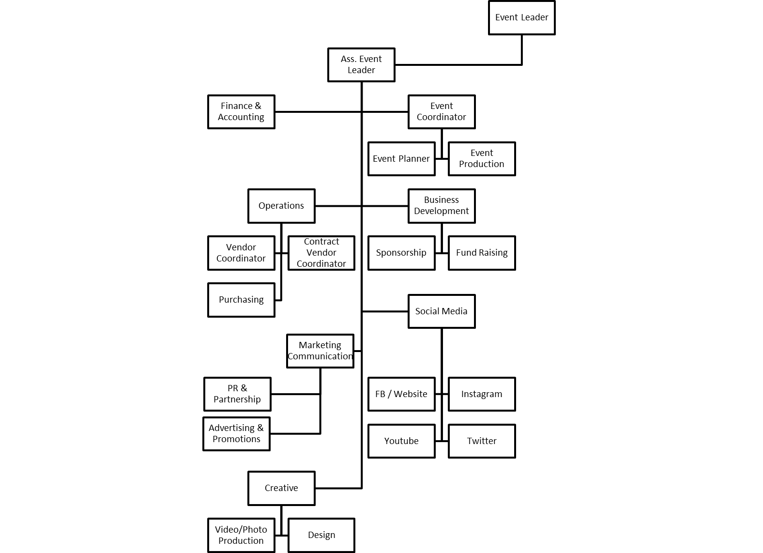

Slide 3
NO | POSITION |  | NAME
1 | Event Leader (1) |  | Muhammad Arkan Faruqi
2 | Assistant Event Leader (1) |  | Krisna Dika Prayoga
3 | Secretary (5) | Manager (1) | Ryan Harna Dwi Putra
 |  | Secretary (4) | Tigy Ambar Silvanari
 |  |  | Frizka Lenka Tantra
 |  |  | Rania Eka Nurmalina
 |  |  | Laksmidra Qurin
4 | Finance & Accounting (3) | Manager (1) | Monita Aprilia Cahyadi
 |  | Finance & Accounting (2) | Shafarania Khansa
 |  |  | Sarah Marline

Slide 4
5 | Event Coordinator (12) | Manager (1) | Tubagus Fabiansyah
 |  | Event Planner (5) | Danisa Amanda Ardianti
 |  |  | Sitta Fauziah
 |  |  | Khansa Nur Aini
 |  |  | Nazla Sanannisa
 |  |  | Khairina
 |  | Production Planner (7) | Erviny Yurike
 |  |  | Putri Aisyah
 |  |  | Nuansa Islami
 |  |  | Jelang Titah Baskara
 |  |  | Riyansyah Samad
 |  |  | Anly Supiandi
 |  |  | Fadil Alifiandi

Slide 5
6 | Operations (11) | Manager (1) | Mohammed Aldrich
 |  | Vendor Coordinator (5) | Danang Trishadanarta
 |  |  | Infani Zakia Zulfa
 |  |  | Rara Neva Kirana Fitrisnisya
 |  |  | Zapatha Nurhadi Haikal Ibrahim
 |  |  | Priesta Amanda
 |  | Contract Vendor Coordinator (2) | Muhammad Ridwan
 |  |  | Andanu Lazuarki Pratama
 |  | Purchasing (3) | Anya Narawita Naryakusuma
 |  |  | Tri Noval Perdana Jafar Siddiq
 |  |  | Aji Anugrah Putra

Slide 6
7 | Business Development (12) | Manager (1) | Radityo Kusumo Putra Kardi
 |  | Sponsorship (5) | Tasya Oki Setyowati
 |  |  | Novira
 |  |  | Kirana Pitaloka
 |  |  | Atika Masrura
 |  |  | Monica Dina Putri
 |  | Fund Raising (7) | Adhi Maulana
 |  |  | Nonafianti
 |  |  | Salzadilla Aprilyan
 |  |  | Fitriatul Intiha
 |  |  | Fairuzista Anya Anindya
 |  |  | Rahmi Syafarina Habibti
 |  |  | Aldino Takari

Slide 7
8 | Marketing Communication (13) | Manager (1) | Rega Ervanto
 |  | PR & Partnership (6) | Rehan Budi Setiawan
 |  |  | Raden Agnescy Ernawan
 |  |  | Rayhan Riffai
 |  |  | Cornelius Indra Cahya
 |  |  | Arthi Intan Permatahati
 |  |  | Farah Millenia A
 |  | Advertising & Promotion (6) | Kadek Alvia Raspati
 |  |  | Nada Berliana
 |  |  | Salsa Fadila
 |  |  | Farhana Rizkita Yanti
 |  |  | Dida Switania O
 |  |  | Alya Iasha Pramesti

Slide 8
9 | Social Media (12) | Manager (1) | Wahyu Nur Insan
 |  | FB / Website (3) | Salsabilla Firda Andriani
 |  |  | Annisa Nur Aisyah
 |  |  | Anysa Tyara Oktaviana
 |  | Instagram (3) | Annisya Ristifani
 |  |  | Lystra Elizabeth Theofilus
 |  |  | Ardhatama Dellano Mauritz
 |  |  | Avifah Yuthika
 |  | Youtube (3) | Gufron Ghifari Latuconsina
 |  |  | Ivana Thalia
 |  |  | Muhammad Rizky Aswina Putra
 |  | Twitter (2) | Anisa Dhamayanti
 |  |  | Luthfi Setyawan

Slide 9
10 | Creative (11) | Manager (1) | Faiz Salman Zuhdi Dano
 |  | Video / Photo Production (5) | Rayhan Arya Fascinar
 |  |  | Aulia Jabbar Rohman
 |  |  | Ramadhandy Arya P
 |  |  | Fikri Ananda Purnama
 |  |  | Muhammad Dafa Maulana
 |  | Design (2) | Hardy Pranata
 |  |  | Muhammad Hanif Putra Primadi

Slide 10
THANKYOU

