Slide 1
The SEO WAY
Prepared by
emma Aliudin
for UPJ

Slide 2
SEO skills
are important as the 5W that every journalist learn.
(Shane Richmond 2008,
Daily Telegraph).

Slide 3
SEO?WHY?
Konten menarik? Ya!
Konten penting? Ya!
Konten harus bisa ditemukan.

Slide 4
To be number one
3
2
1

Slide 5
SEARCH ENGINE
originally, the term search engine referred to some kind of search index, a huge database containing information from individual Web sites.
Search engine adalah mesin pencari. Istilah ini merujuk pada jenis pengindeks, sebuah database sangat besar, berisi informasi dari website-website individu.

Slide 6
SEARCH ENGINE OPTIMIZATION
Search engine optimization: refers to 'optimizing' web sites and web pages to rank well in the search engines.
Optimalisasi website agar berada di peringkat atas di mesin pencari.
(Online Journalism, the Essential Guide)

Slide 7
The Terms You Have to Know

Slide 8
Search term
word or words, that someone types into a search engine when looking for information.
Kata atau kata-kata yang digunakan pada mesin pencari untuk mencari informasi.
#keyword

Slide 9
Search site
This Web site lets you search through some kind of index or directory of Web sites, or perhaps both an index and directory. ex:?
Website yang memungkinkan melakukan pencarian melalui jenis indeks atau website, atau melalui indeks dan direktori

Slide 10
Search results
results are the information (the results of your search term) returned to you when you go to a search site and search for something.

Slide 11
Natural search results
a link to a web page can appear on a search results page two ways:
the search engine may place it on the page because the site owner paid to be there (pay per click ads) or
it may pull the page from its index because it thinks the page matches the search term well. These free placements are often known as natural search results, or organic search results, or algorithmic search results.

Slide 12
SEO, Is It Important for Journalist?
“Keywords that the search engine knows are commonly asscociated with the search term. So if someone type ‘credit crunch’ into a search engine, the computer knows that an article about the credit crunch often contains other words, such as ‘financial crisis’, ‘bail out’ or ‘bailout’, ‘banks’, ‘recession’ and so on.”
(Shane Richmond, Online Journalism, The Essential Guide)

Slide 13
Choose the right keyword
Pilihan kata kunci yang tepat
Contoh kata Cara dan kata Tips, mana yang lebih banyak digunakan untuk mencari?

Slide 14
Where to put the keywords?
The page title-words that appear in the title bar at the top of the browser. This is often the same as the story headline, but longer with more keywords;
The headline- This should stand alone. Never rely on an image to explain a headline;
The list paragraph of body copy;
The last paragraph.

Slide 15
Keyword placement
Penempatan kata kunci:
Idealnya supaya optimal di mesin pencari kata kunci dijadikan nama domain.
Tapi untuk website yang dinamis -yang banyak mengunggah artikel- kata kunci wajib dimasukkan ke dalam judul, paragraf pembuka (teaser/intro) dan bodi artikel

Slide 16
The Do’s!
Ensure articles are filed correctly and logically: Tag your stories using appropriate keywords from your article.
The most useful tags are the names of people and places mentioned in the story.

Slide 17
Click & Share!
Encouraging sharing of your content on social media: After search engines, social media is an important driver of traffic to news sites.
So, promote your content on social media and encourage your users to share content they like on your site with their friends.
Backlink

Slide 18
SEO TOOLS
Keyword revealer
Keyword Finder
Keyword Tool
Google Suggestion
Trends.google.com

Slide 19
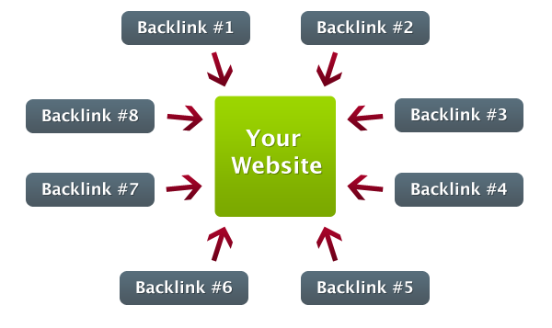
backlink

Slide 20
backlink
Backlink adalah sebuah link yang ditanamkan di berbagai website lain dan mengarahkannya ke website Anda atau website lain yang sedang dioptimasi.
Konten diunggah ke website lain yang memiliki domain authority (peringkat website) jauh lebih tinggi
untuk meningkatkan peringkat website pada mesin pencari
meningkatkan popularitas website
menaikkan pagerank

Slide 21
One way backlink
Blog Comment:Menyertakan url website pada setiap blog comment dengan anchor text yang akan dioptimasi
Signature Forum. Beberapa forum memiliki signature yang akan terpasang setiap kita melakukan post, dapat dimanfaatkan untuk mendapatkan backlink 1 arah untuk website yang sedang dioptimasi.
Social Bookmark. Social bookmark merupakan sebuah website di mana kita dapat men- Submit website tersebut dan menjadikannya “Bookmark”.

Slide 22
LET’S PRACTICE!

