Slide 1
7 News Values
Memahami nilai berita dalam jurnalistik
By Emma Aliudin

Slide 2
WHAT IS NEWS?
News is what the editor thinks is news
“A view of reality gathered quickly under difficult circumstances” (De Fleur & Dennis, 1998)
A recounting of factual information about events, situations and ideas that interests an audience and helps the audience deal with the surrounding environment (Metzler, 1985)

Slide 3
News values adapt to the medium
Television
Television can transmit moving pictures of news events directly into viewers’ homes. The pictures enable viewers to observe the story for themselves. Thus good pictures are essential for television news
Radio
Tends to be dramatic. It’s a theatre of mind.

Slide 4
NEWS JUDGMENT
Pertimbangan (penilaian) tentang apa yang dianggap menarik/penting untuk diketahui oleh audiens
Menentukan peristiwa yang akan diliput
Menentukan waktu tayang
Menentukan urutan berita yang akan dibacakan

Slide 5
IMPACT=DAMPAK
Seberapa besar dampaknya?

Slide 6
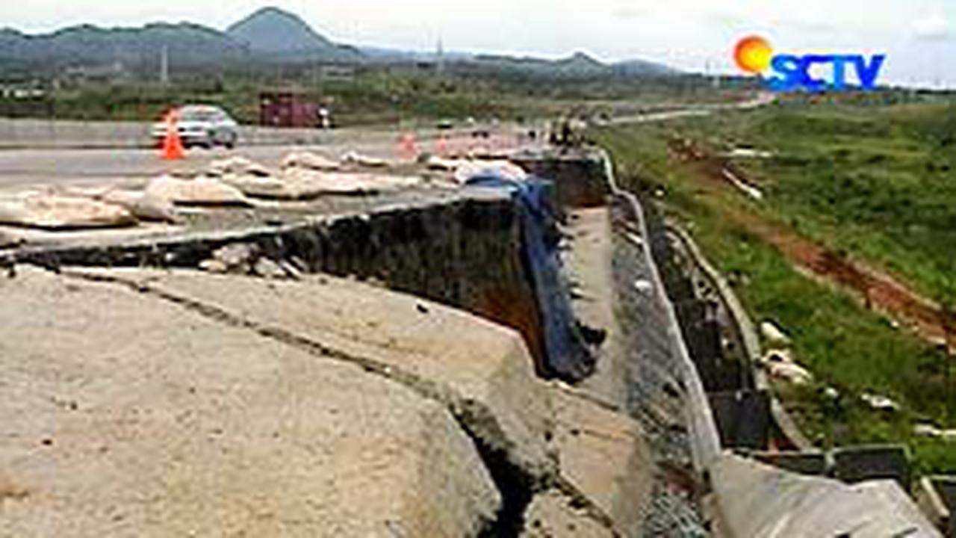

Slide 7
TIMELINESS
Seberapa aktual? Apakah relevan dengan situasi saat ini?
Perkembangan suatu peristiwa

Slide 8
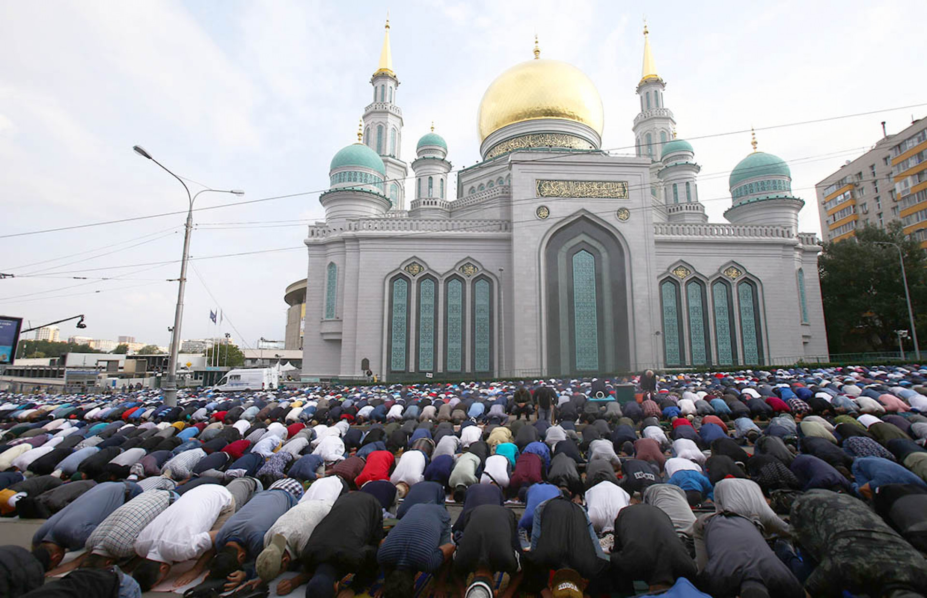
Russia's Muslims celebrated the religious holiday of Kurban Bayram, or Eid al-Adha, on Tuesday. Tens of thousands of worshippers congregated at Moscow's Cathedral Mosque for prayers on the "Festival of Sacrifice," which celebrates the willingness of Ibrahim to sacrifice his son on a command from God.
Moskva News Agency

Slide 9
PROXIMITY
Kedekatan dengan audiens
Notes:
Ask students to define impact.

Slide 10
PROXIMITY
Kedekatan secara fisik
Kedekatan emosional
Intinya, audiens merasa terhubung
dengan hal yang diberitakan

Slide 11
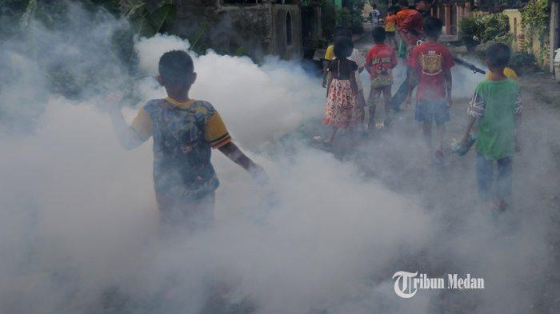

Slide 12
PROMINENCE
Seberapa penting? Seberapa terkenal?
Notes:
Ask students to define impact.

Slide 14
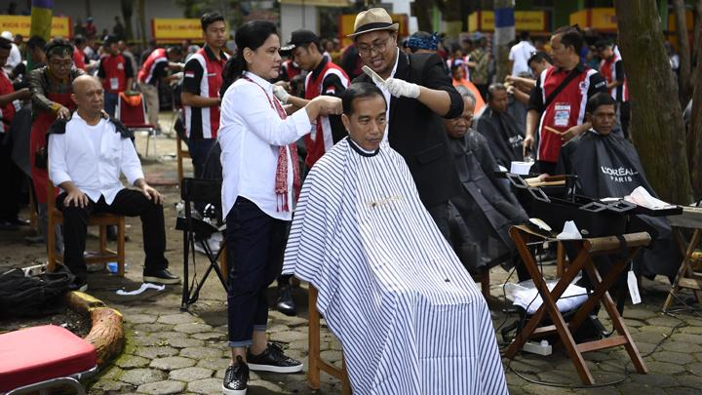

Slide 15
CONFLICT
Ada pertentangan, kontroversi, cekcok
Notes:
Ask students to define impact.

Slide 16
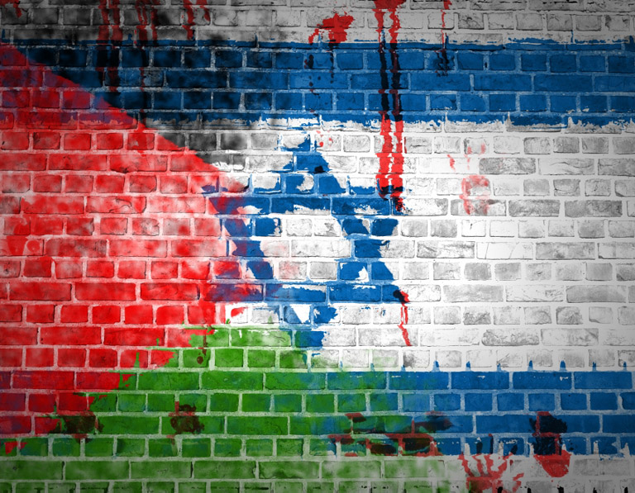
Millennialsmagazine.com

Slide 17
NOVELTY
Ada unsur kebaruan, unik, bukan hal yang biasa ditemui
Notes:
Ask students to define impact.

Slide 18
USEFULNESS
Bermanfaat
Notes:
Ask students to define impact.

Slide 19
USEFULNESS
Informasi yang dibutuhkan audiens untuk menjalani hidup
Berita yang memberikan panduan, cara
Berita yang mendatangkan rasa aman, nyaman
Berita yang membantu meningkatkan kualitas hidup

Slide 20
LET’S PRACTICE!

Slide 21
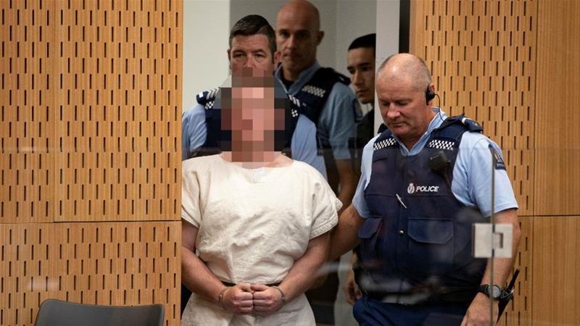

Slide 22
New Zealand mosque attacks: Wrong person listed as a victim
New Zealand police say they made an error and the man the main suspect is accused of killing is not dead.
21 Mar 2019
New Zealand police say they made a mistake when they charged the man believed responsible for the country's worst massacre that killed 50, and that the victim they allege he murdered is alive.
"An error was made in the charging document prepared for the first court appearance of the man charged with murder in relation to the Christchurch terror attacks. The error saw an incorrect victim name included in the charging document," a police spokesman said in a statement.
Police charged an Australian citizen on Saturday with a single count of murder of one man, with further charges expected when the alleged attacker is due back in court on April 5. The police now say that victim is not dead.

