Slide 1
Excavators
Lecture 7
TSP-308 MPK Ferdinand Fassa

Slide 2
OUTLINE
Introduction
Type of Excavator

Slide 3
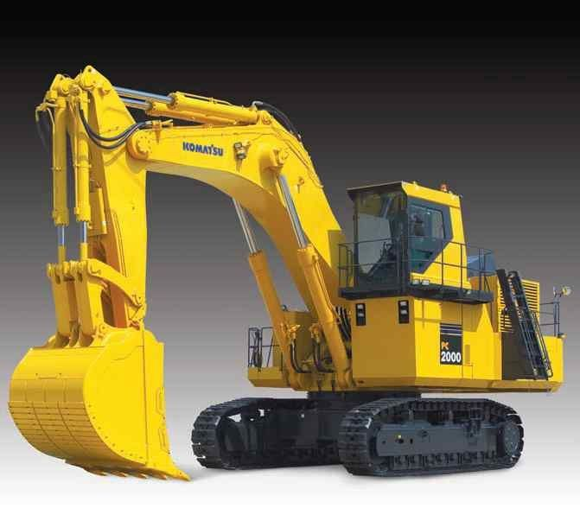
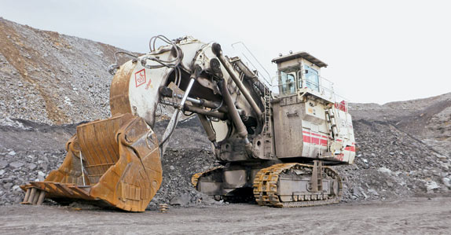
INTRODUCTION
Hydraulic front shovel are used for hard digging above track level and for loading haul units
Hydraulic hoe excavator are used to excavated below natural surface of the ground on

Slide 4
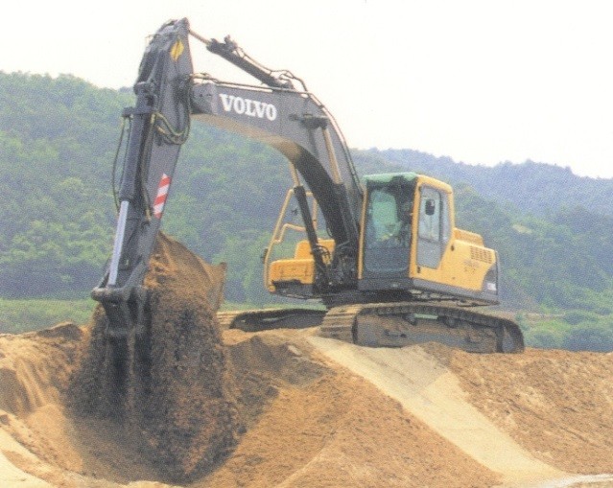
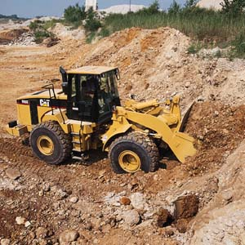
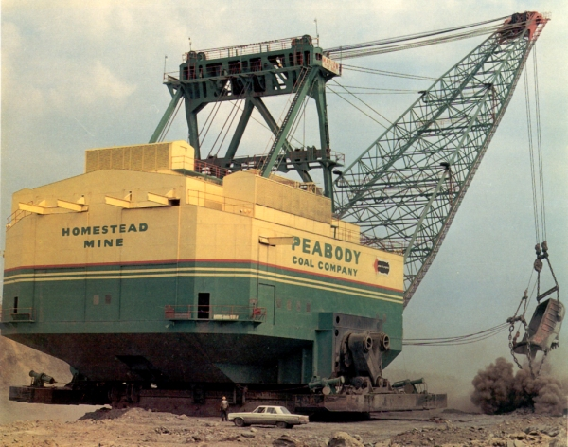
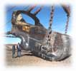
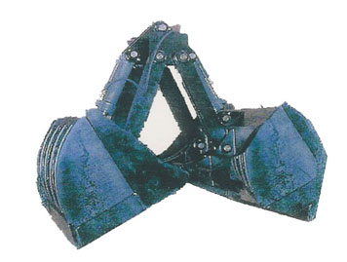
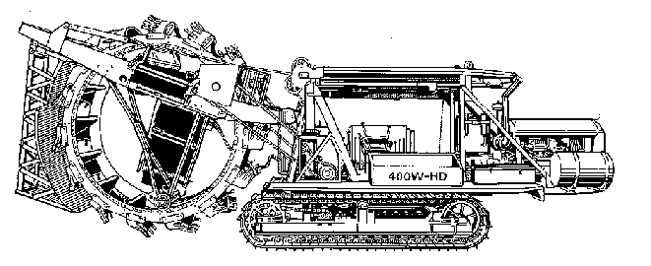
Type of Excavators
Backhoes
Front Shovels (Power Shovels)
Draglines
Clamshells
Trenchers

Slide 5
Excavators
excavate and load dirt (soil/aggregate) to haulers

Slide 6
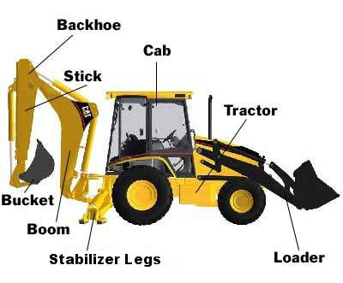
Anatomy of Excavator

Slide 7
Draglines

Slide 8
Under Carriage
Wheel-Mounted
Crawler-Mounted
Truck-Mounted

Slide 9
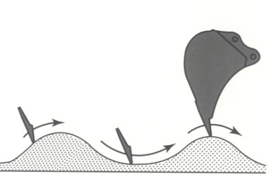
Factors Affecting Excavators’ Productivity
Types and characteristics of soils
Depth of Cut
Angle of Swing
Types and sizes of buckets
Length of boom
Efficiency and condition of equipment
Efficiency and condition of work

Slide 10
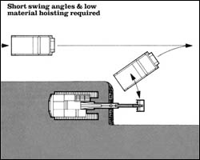
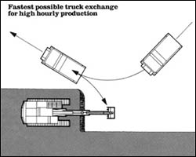
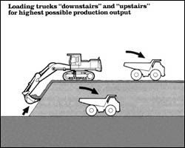
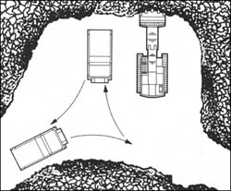
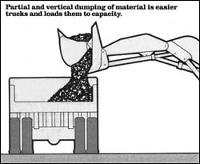
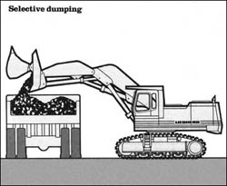
Loading Mechanism

Slide 11
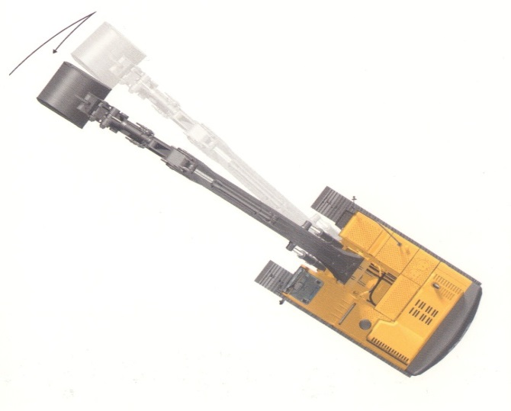
Excavator Productivity
Bucket Capacity (manufacture listed specs)
volume (heaped / struck)
weight (static tipping load, front or side, outriggers)
Bucket Fill Factors (type of material)
Cycle Time
Load-raise, swing, dump, swing back, lower,
Correction Factors
Bucket Fill factor
% Optimum Depth of Cut – Angle of Swing
working and management conditions
P = corrected bucket capacity / cycle time

Slide 12
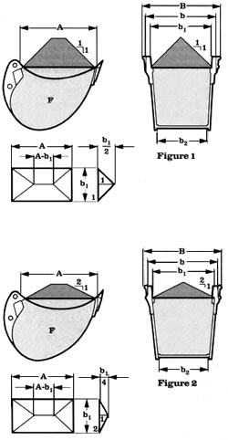
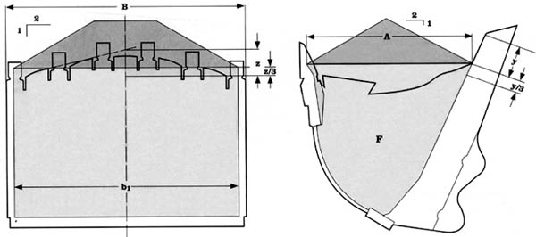
Buckets

Slide 13
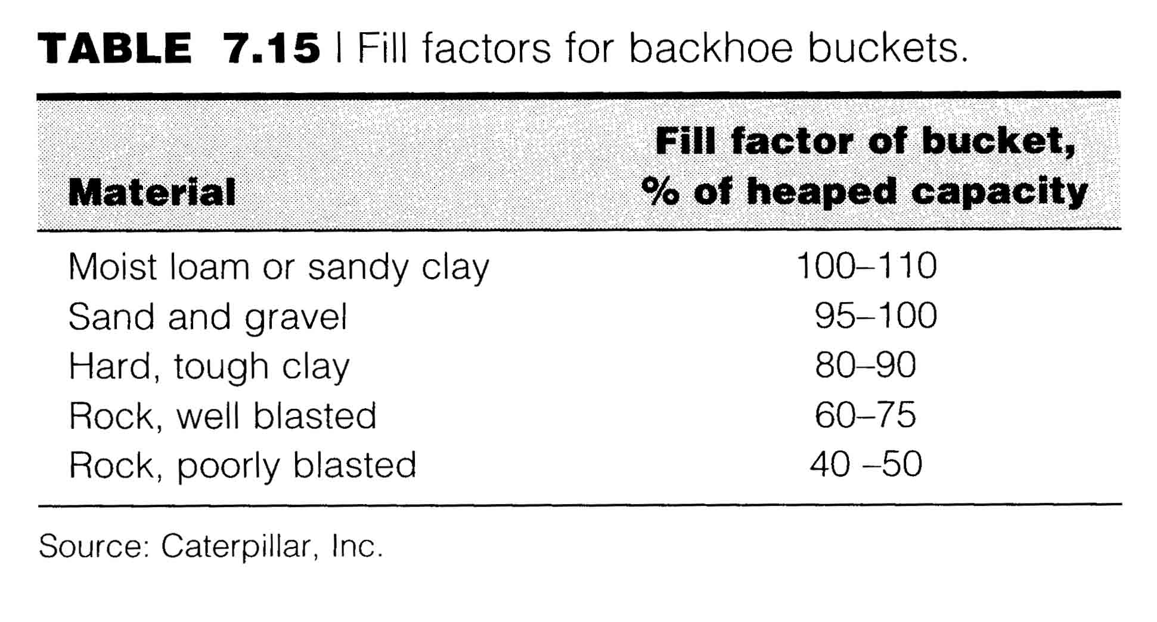
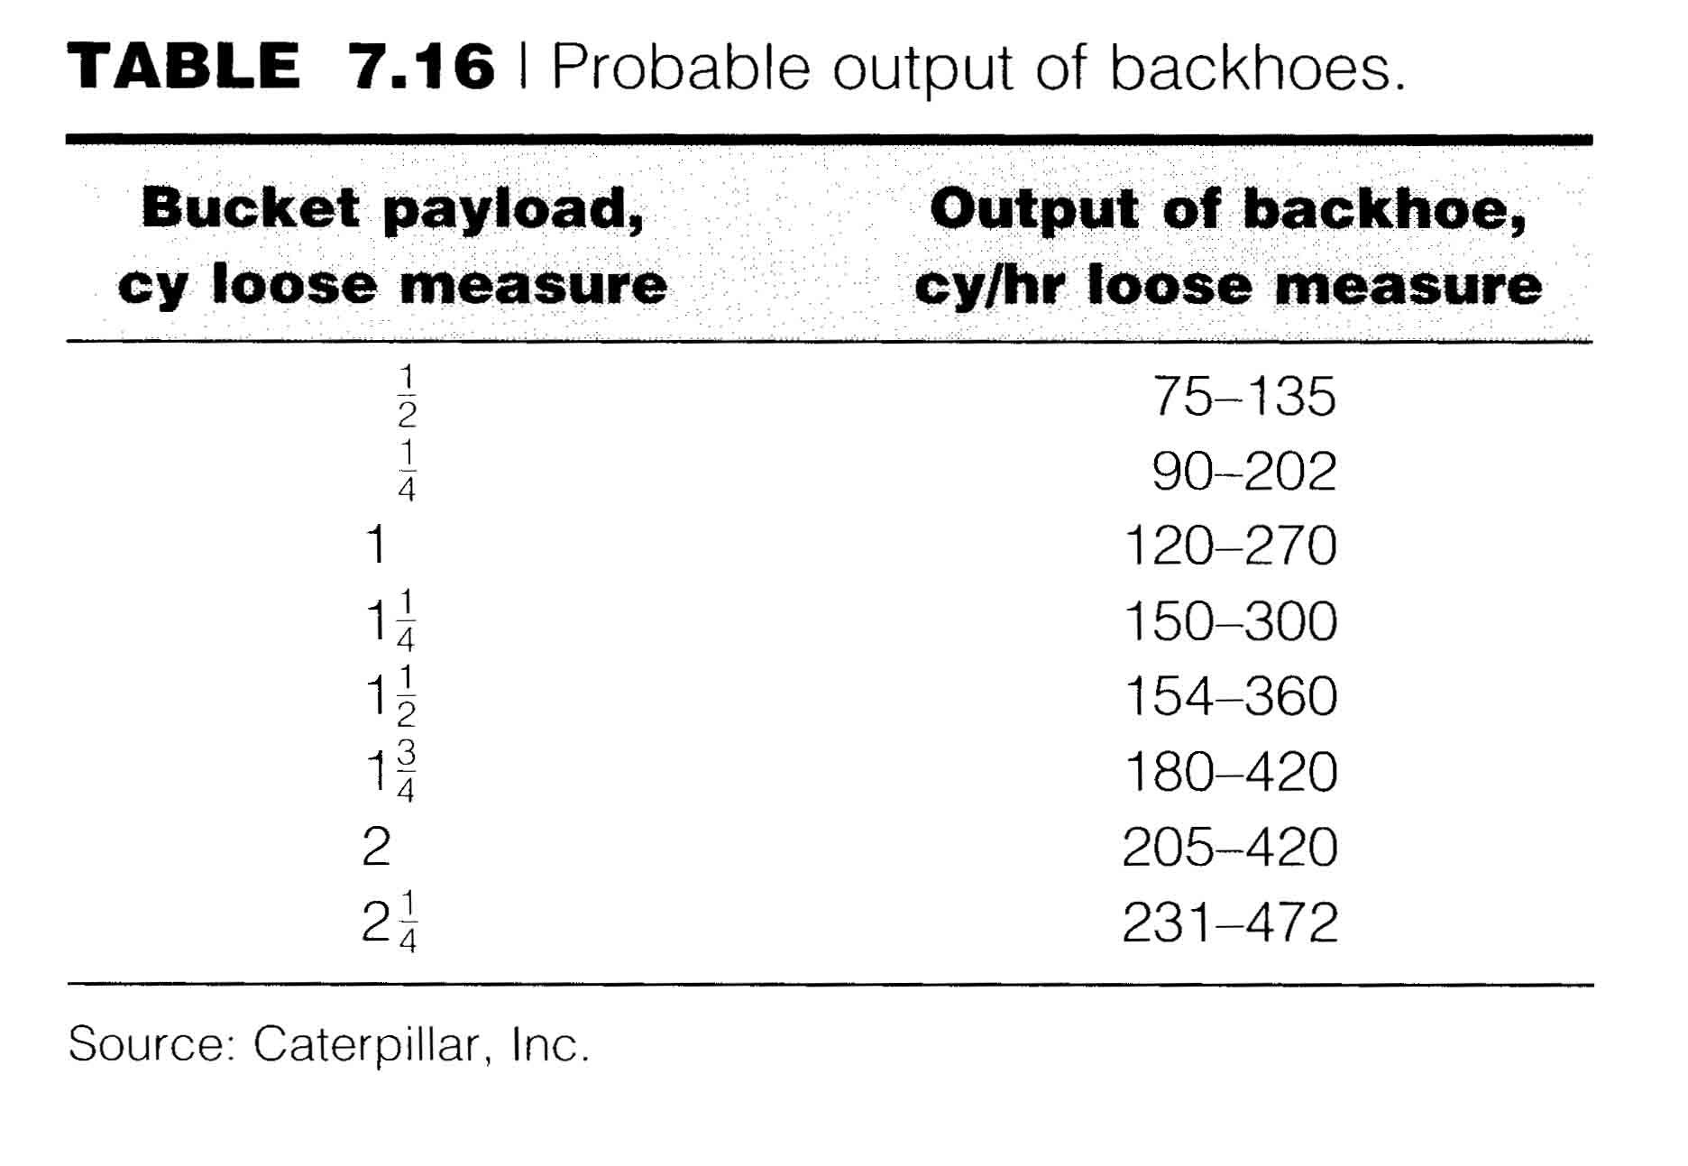
Tables for Backhoe

Slide 14
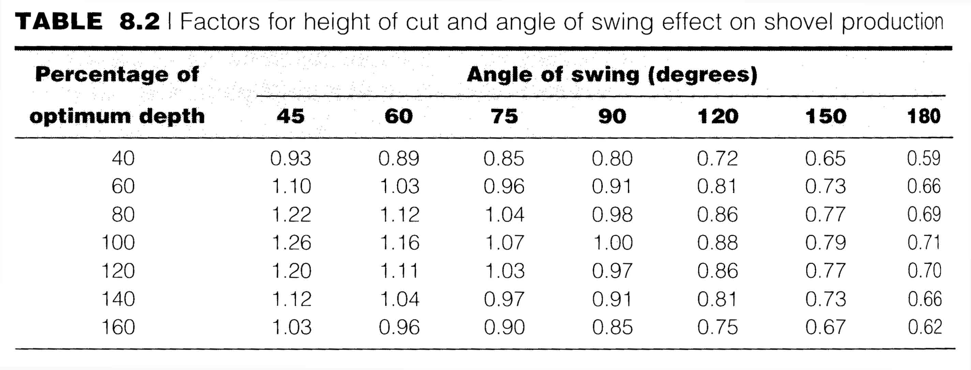
Correction factor for Opt. Depth of Cut – Angle of Swing

Slide 15
exercise
Determine actual productivity of a backhoe loader having
optimum dept of cut of 2.2 m and working to excavate sand at depth of 2.5 m and angle of swing 150º. Bucket size is 3 cy.
Percent swell 26%
Working in 40 min-hour.
Total cycle time = 20 sec
bucket fill factor 95%
bucket load = 95% * 3 cy = 2.85 Lcy
% opt. depth of cut = dept of excavation/ max dept
= 2.5 m/2.2 m
=114%
Correction factor:
= 1/(1+ swell factor)
= 1/(1+0.26) → 0.79
Estimated productivity:
= (bucket size x fill factor x working efficiency) cycle time
(2.85 Lcy x 0.79 x 40/60) / 20 = 0.075 lcy/s x 3600 s
= 270 Lcy/hr

Slide 16
Next
Lecture 8
CONSTRUCTION EQUIPMENT AND METHODS

