Slide 1
PROJECT DOCUMENTATION
Lecture 12
Ferdinand Fassa

Slide 2
Outline
Review Lecture 11
What is a project document?
Why and When is a project document required? Is necessary?
Steps in developing a project document
Documentation of Construction Progress
Documentation of Safety Hazards & Violations
Minutes of Meetings
Construction Photographs

Slide 3
What is a Project document?
There are two key words:
Project
Document
A project refers to a specific undertaking that is to be carried out within an identified time frame.
A document is a record of information relating to a particular subject or matter.

Slide 4
A project document is a record of information about a venture or undertaking. This type of document:
Is descriptive(background, and type of project)
Outlines the process of implementation
Is analytical (context and conditions influencing the project and tracking mechanisms)
Identifies risks, challenges and benefits)
Identifies cost and possible sources of funding.

Slide 5
Why A Project Document Is Required
As proof of understanding about what is to be done
Evidence of commitment to undertake the venture in view of risks and challenges.
Appreciation of the cost dimensions and acceptance to work within the agreed costs
Measuring tool

Slide 6
When is a project document required?
When a project is conceived/create
As an attachment to support proposal for financial assistance
As evidence that a project is feasible

Slide 7
Is Document necessary?
Yes!
As a reference point regarding the project
Provides information about the project
Serves as reference for preparing other project documents

Slide 8
Steps in preparing a project document
A project document must include the following headings:
1. Project Objective
Project development objective (what the project seeks to do);
Key performance indicators(sets out the indicators to be used to measure and monitor the project outputs and long term outcomes)

Slide 9
2. Project description
project components and sub-components
Key policy and institutional reforms supported by the project
Financial management arrangements
3. Project rationale
Significance of the project
Relate the significance to other projects that have been conducted
Lessons learn and how these are reflected in the project design

Slide 10
4. Cost
The funds required .
5. Sustainability and risks
Sustainability: indicate the long term sustainability of the project.
Risk: identify the critical risks (i.e. these reflect the failures of the critical assumptions related to the project)

Slide 11
6. Monitoring, reviewing and Reporting
7. Annexes: any document that is relevant to the project to which reference is made in the document.

Slide 12
Documentation of Construction Progress
Daily Report
Weekly Report
Monthly Report
Variation Order

Slide 13
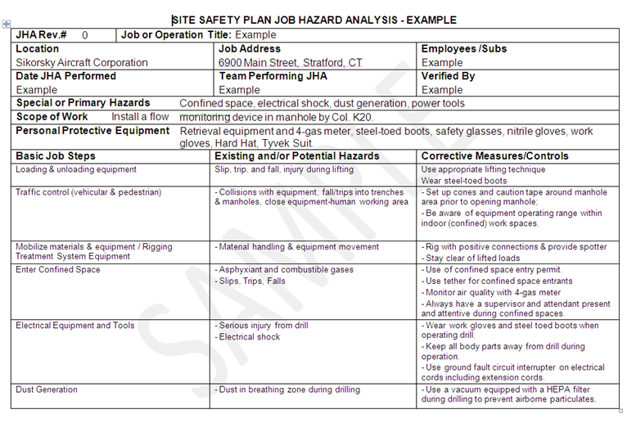
Documentation of Safety Hazards & Violations

Slide 14
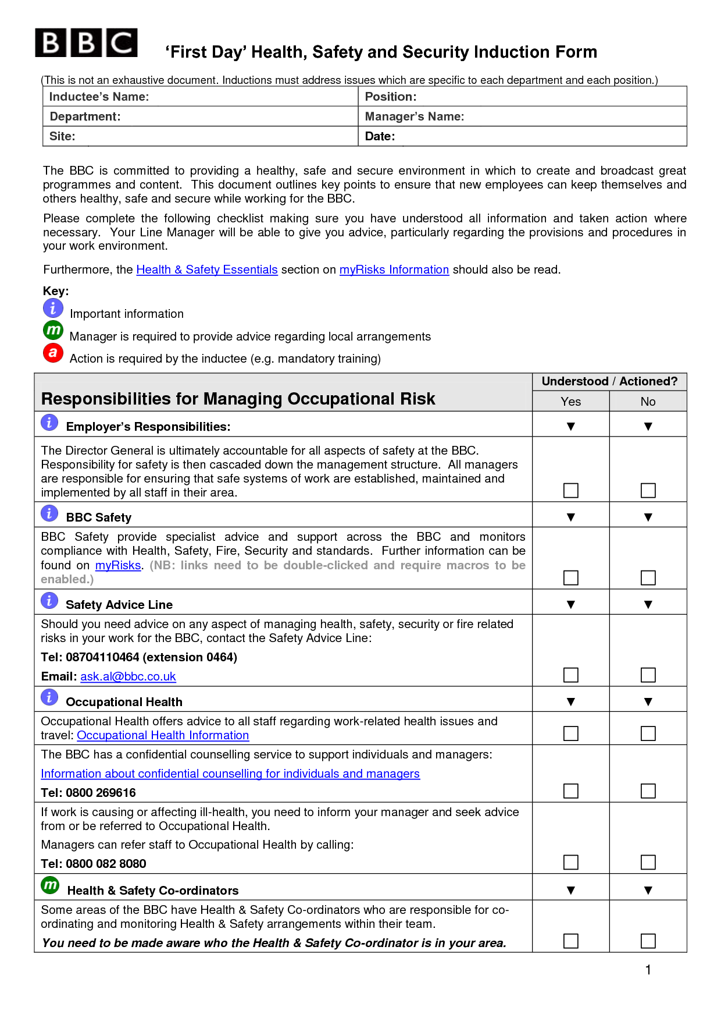

Slide 15
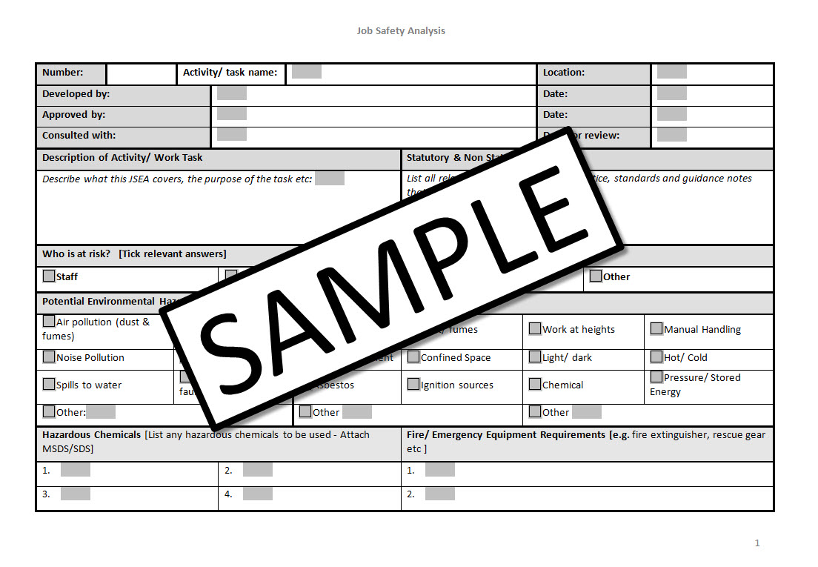

Slide 16
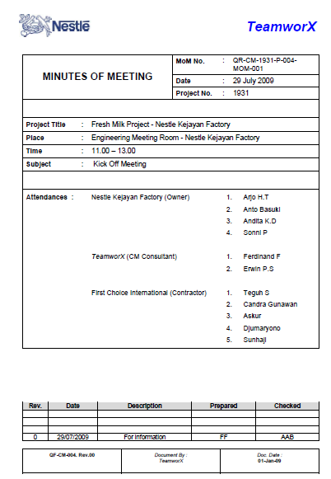
MoM

Slide 17
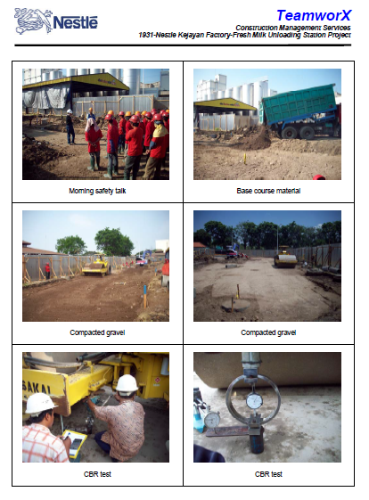
Construction Photographs

Slide 18
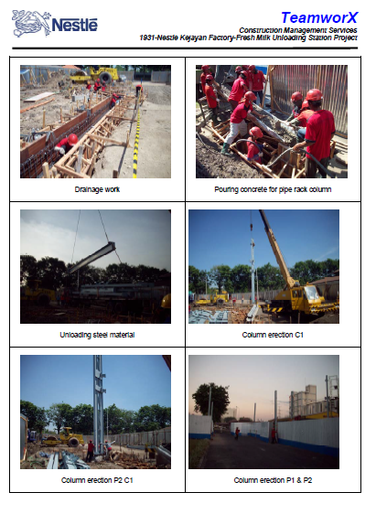
Construction Photographs

Slide 19
Thank You

