Slide 1
Strategic Planning Process

Slide 2
Understanding Strategic Planning Process
Bisa menjelaskan apa itu strategic planning process.
Bagaimana sumber daya organisasi dan opportunities memengaruhi proses perencanaan.
Bagaimana visi misi organisasi memengaruhi proses perencanaan.

Slide 3
Strategic Planning Process
The process of establishing an organizational mission and formulating goals, corporate strategy, marketing objectives, marketing strategy, and a marketing plan.

Slide 4
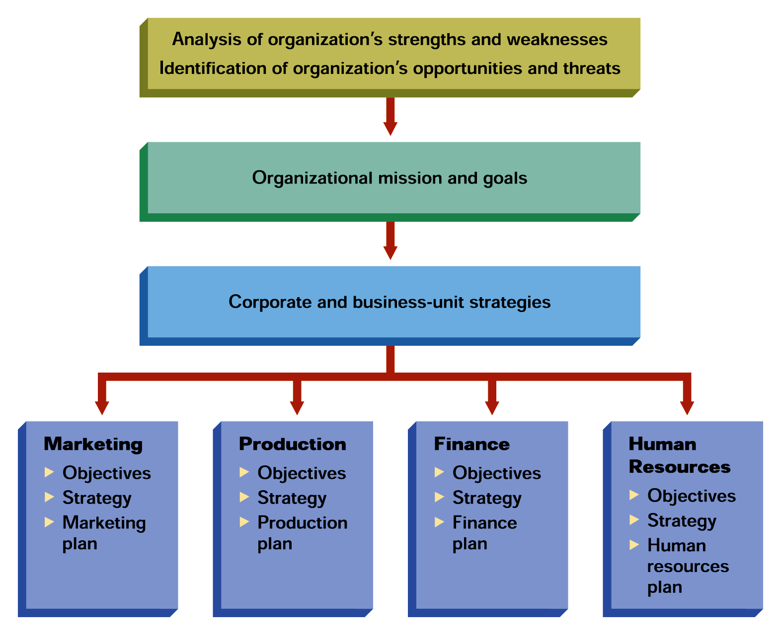
Components of Strategic Planning
Source: Figure adapted from Marketing Strategy, Second Edition, by O. C. Ferrell, Michael Hartline, and George Lucas, Jr. Copyright © 2002. .

Slide 5
Assessing Organizational Resources and Opportunities
Core Competencies
Things a firm does extremely well (strengths), which sometimes give it an advantage over its competition
Financial and human resources
Reputation, goodwill, and brand names

Slide 6
Assessing Organizational Resources and Opportunities
Market Opportunity
A combination of circumstances and timing that permits an organization to reach a target market
Core competencies are matched to opportunities
Strategic windows— temporary periods of optimal fit between the key requirements of a market and the particular capabilities of a firm

Slide 7
Assessing Organizational Resources and Opportunities
Competitive Advantage
The result of a company’s matching a core competency (superior skill or resources) to opportunities in the marketplace
Manufacturing skills
Technical skills
Marketing skills

Slide 8
SWOT Analysis
An assessment of the organization’s strengths, weaknesses, opportunities, and threats
Strengths—competitive advantages or core competencies
Weaknesses—limitations on competitive capability
Opportunities—favorable conditions in the environment
Threats—conditions or barriers to reaching objectives

Slide 9
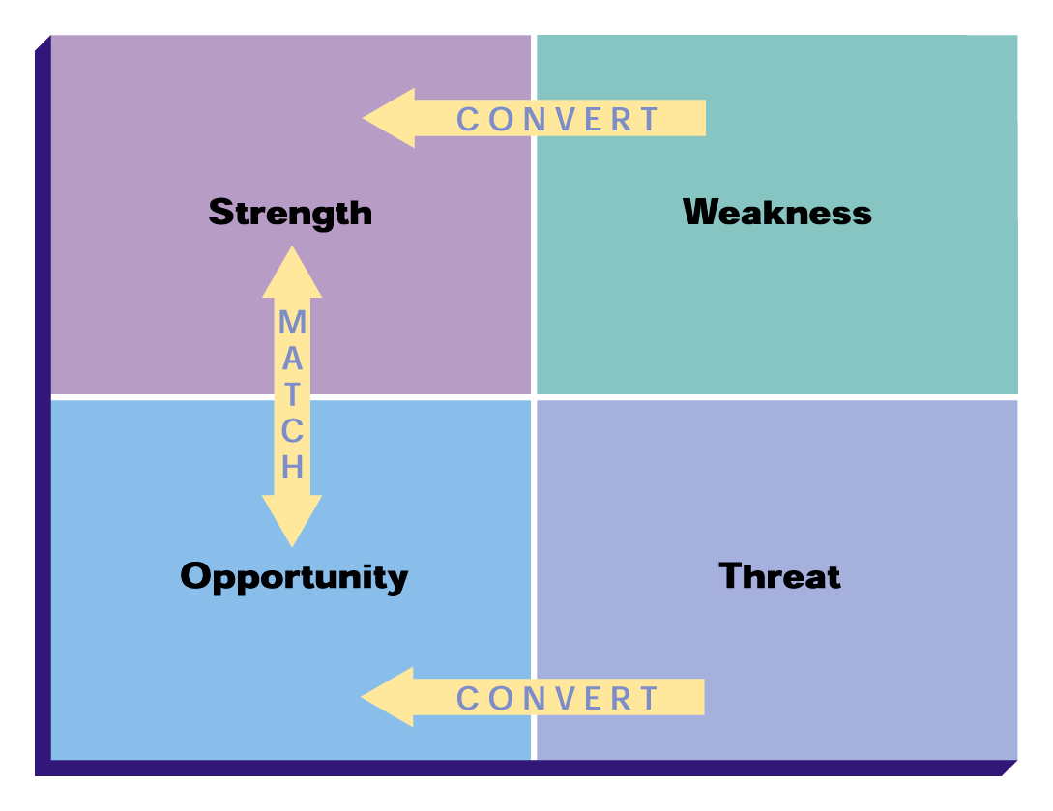
The Four-Cell SWOT Matrix
Source: Reproduced from Nigel F. Piercy, Market-Led Strategic Change. Copyright © 1992, p. 371, with permission from Elsevier Science.

Slide 10
Marketing Strategy and Marketing Plan
Marketing Strategy
A plan of action for identifying and analyzing a target market and developing a marketing mix to meet the needs of that market
Marketing Plan
A written document that specifies the activities to be performed to implement and control an organization’s marketing activities

