Slide 2


List ten (10) things you have purchased in the last month

Slide 3

WHAT IS ECONOMICS?
Economics – the study of how individuals and societies make decisions about ways to use scarce resources to fulfill wants and needs.
https://youtu.be/2YULdjmg3o0
https://www.youtube.com/watch?v=PHe0bXAIuk0&t=520s

Slide 4
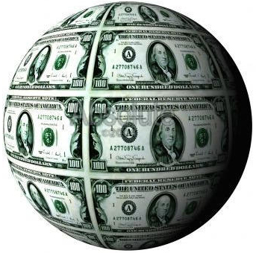

The Study of Economics
Macroeconomics
  The big picture: growth, employment, etc.
  Choices made by large groups (like countries)
Microeconomics
  How do individuals make economic decisions

Slide 5
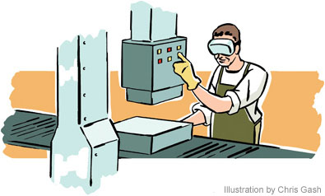
ECONOMICS: 5 Economic Questions
Society (we) must figure out
WHAT to produce (make)
HOW MUCH to produce (quantity)
HOW to Produce it (manufacture)
FOR WHOM to Produce (who gets what)
WHO gets to make these decisions?
https://www.youtube.com/watch?v=G6iRy-AISZs

Slide 6

Do Now:
List five (5) of your favorite items (goods) (boots, phone, etc.
Where did you buy these items?
Where were they made?

Slide 7



What are resources?
Definition: The things used to make other goods

Slide 8


BUT, there’s a
Fundamental Problem:
SCARCITY: unlimited wants and needs but limited resources

Slide 9
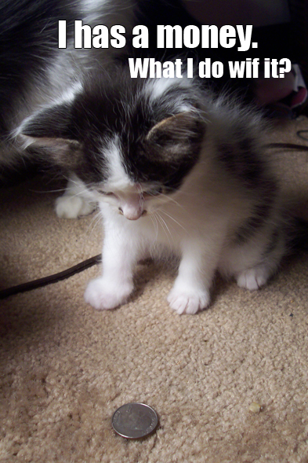
Choices, Choices
Because ALL resources, goods, and services are limited – WE MUST MAKE CHOICES!!!!

Slide 10
Why Choices?
We make choices about how we spend our money, time, and energy so we can fulfill our NEEDS and WANTS.
What are NEEDS and WANTS?

Slide 11
Wants and Needs,
Needs and Wants
NEEDS – “stuff” we must have to survive, generally: food, shelter, clothing
WANTS – “stuff” we would really like to have (Fancy food, shelter, clothing, big screen TVs, jewelry, conveniences . . . Also known as LUXURIES

Slide 12


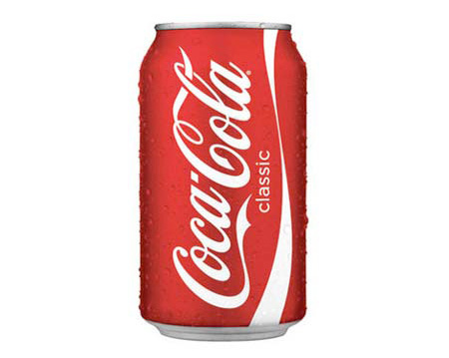
VS.

Slide 13
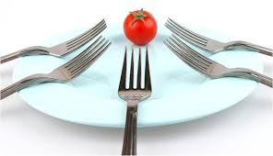
https://youtu.be/yReZ4xdg5bw

Slide 14
TRADE-OFFS
You can’t have it all (SCARCITY – remember) so you have to choose how to spend your money, time, and energy. These decisions involve picking one thing over all the other possibilities – a TRADE-OFF

Slide 15


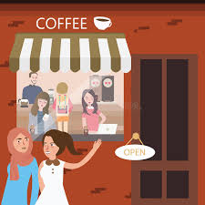
Trade-Offs, cont.
What COULD you have done instead of come to school today?

Slide 16
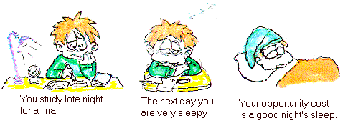
The result of your Trade-Off is the
OPPORTUNITY COST =
The Value of the Next Best Choice
(Ex: Sleeping is the opportunity cost of studying for a test)

Slide 17
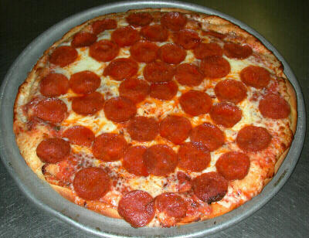
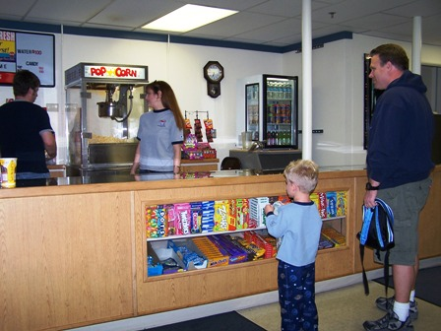
Opportunity Costs
This is really IMPORTANT – when you choose to do ONE thing, its value (how much it is worth) is measured by the value of the NEXT BEST CHOICE.
  This can be in time, energy, or even MONEY
If I buy a pizza…
Then I can’t afford the movies…
Q: What is the opportunity cost of buying pizza?

Slide 18
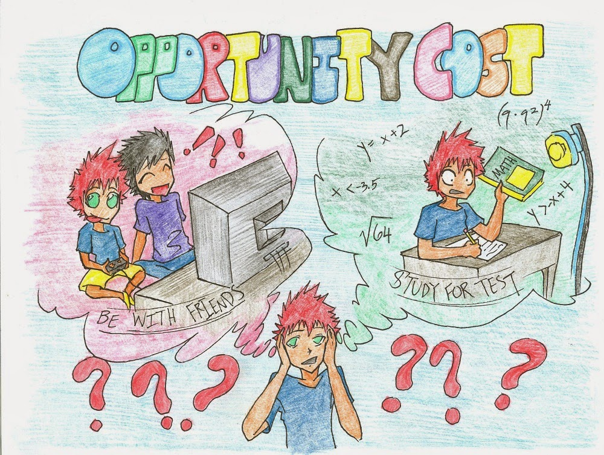
https://youtu.be/TNxg1auV2AM

Slide 19
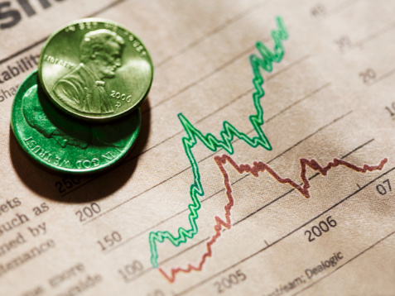
INTRODUCTION TO ECONOMICS
Wrap Up
Choices, Choices, Choices, . . .

Slide 20
THANK YOU

