Slide 1
07 PENELITIAN DESKRIPTIF
Kuliah 07
METODOLOGI PENELITIAN & STATISTIK DESKRIPTIF
(Aries Yulianto, s.psi., m.si)
C h A P t E R 6 The Descriptive Research Strategy

Slide 2
1. The Observational Research Design
A. behavioral observation
2. Sampling Observations 3 procedures of sampling observations: (p.317)
1. Time sampling
2. Event sampling
3. Individual sampling

Slide 3
1. The Observational Research Design
A. behavioral observation
Types of observation: (p.319)
1. Naturalistic Observation
2. Participant Observation 3. Contrived Observation

Slide 4
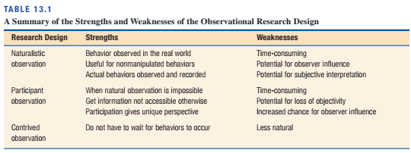
1. The Observational Research Design

Slide 5
2. The Survey Research Design
a research study that uses a survey to obtain a description of a particular group of individuals. (p. 323)
Types of Questions:
Open-Ended Questions (p.324)
Restricted Questions (p.325)
Rating-Scale Questions (p.325)

Slide 6
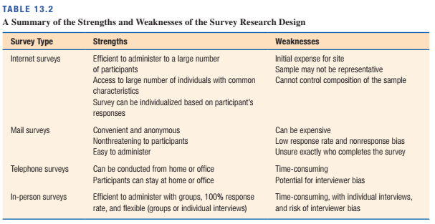
2. The Survey Research Design

Slide 7
3. The Case Study Design
The case study design involves the in-depth study and detailed description of a single individual (or a very small group). A case study may involve an intervention or treatment administered by the researcher. When a case study does not include any treatment or intervention, it often is called a case history. (p. 334)
Applications of the Case study Design:
Rare Phenomena and Unusual Clinical Cases (p.335)
New Therapy Methods or Applications (p.335)

Slide 8
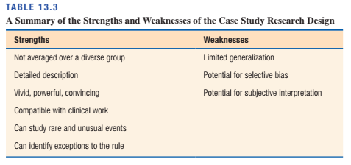
3. The Case Study Design

